Slide 1
Stage 3 Reopening Plans and Procedures

Slide 2
Agenda
This Town Hall is meant to be a two-way street!
Overview of the state of play: where we are in the reopening process and what comes next
Discuss resources for students/postdocs/staff during reopening
PIs to share reopening plans and discuss with their group
Students/postdocs/staff should not be forced to participate in Stage 3 if they are CDC high risk
New MS Teams channel “Lab Hacks for Covid Safety”
Anonymous poll for reporting concerns
Q&A for Stage 3 reopening

Slide 3
Overview and Current State of Play
S&I has been working to buffer faculty from ASC and OR directives, developing templates, best practices, etc. to minimize burden on PIs
PIs have been extremely thoughtful, responsive, and willing to work towards the common good
As a result:
Physics has been officially approved for restart on Monday June 22nd with no changes to our reopening plan
Physics reopening plan flagged as “best practice” by college
We are ready to restart research activities!

Slide 4
Operating in the PRB
Access to the PRB will be by swipe card entry only as per the PRB Reopening Plan
Personnel will enter the PRB through the North door and use the North stairway to go up to the lab, exit the PRB through the South stairway and exit the PRB through the South door as per the PRB Reopening Plan
Our plan for safe distancing operations is to have one person per 150 sq ft in the lab. Each person will be required to put on a face mask before entering the PRB and wear it during their full access to the PRB.

Slide 5
Operating in the PRB
The PRB Office side is currently closed.
Everyone should follow university/department policy on health checks when coming to campus, and wear a mask at all times.
Our workforce will maintain safe distancing from others in the PRB and each other at all times. While in the PRB, our personnel agree to maintain strict single-occupancy use of elevators or bathrooms.
Cleaning of the workspace and related tools, keyboards, phones, and machines will be the responsibility of each worker.

Slide 6
Contact Your Supervisor!
Make sure you are familiar with your lab plan, building plan, general operations
Make sure you know what your supervisor expects of you
Let them know you have completed all the relevant university trainings and restart forms (https://go.osu.edu/returningtocampus)
Update your health tracking for lab entry daily!

Slide 7
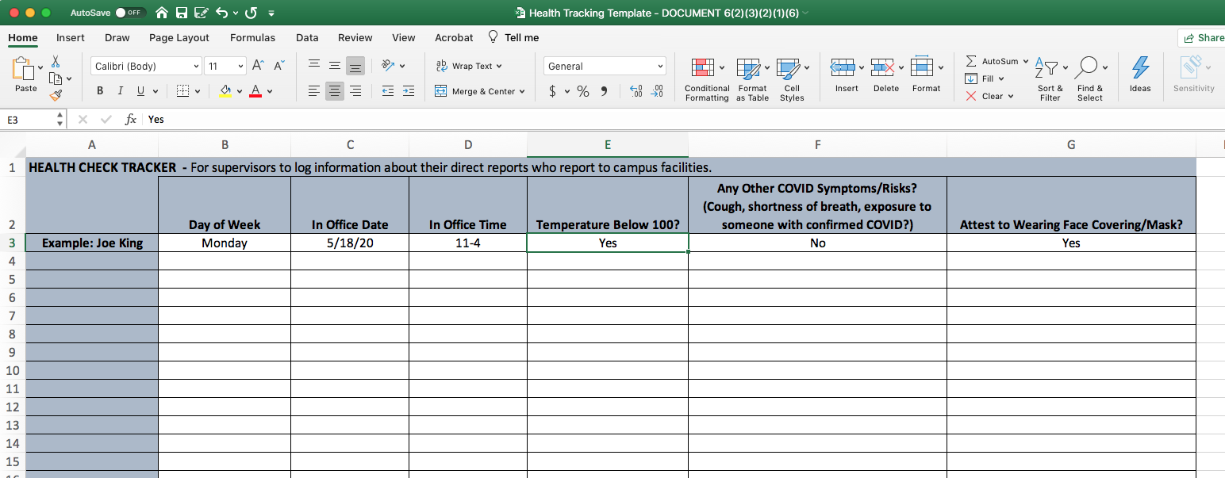
Daily Health Tracking:

Slide 8
Daily Health Tracking:
Used for contact tracing, so need to know who is in a given lab at a given time
Shared with S&I and periodically reviewed

Slide 9
Resources for students/staff/postdocs
PIs should share reopening plans and discuss with their group
New MS Teams channel “Lab Hacks for Covid Safety”
Anyone who is uncomfortable returning to campus during Stage 3 is not obligated to do so
Anyone with concerns about returning should bring them to their supervisor, the Chair, S&I, grad studies, their thesis committee, or use the anonymous survey below
Anonymous poll for reporting concerns: https://go.osu.edu/si-reporting

Slide 10
Questions?
johnston-halperin.1@osu.edu

