Slide 1
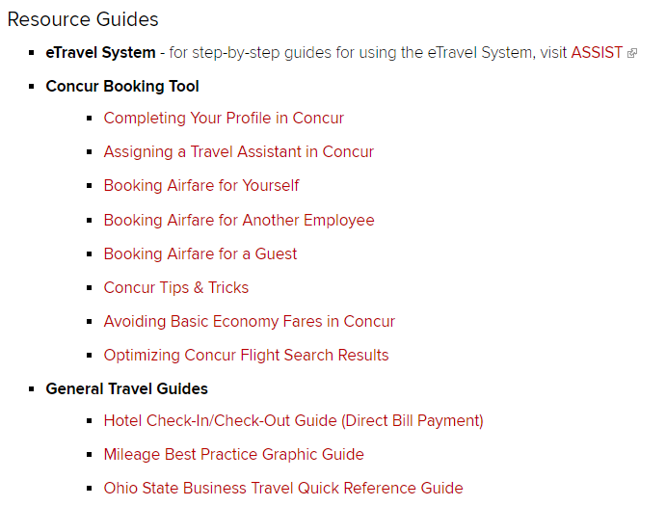
Travel Office Resources
Website (go.osu.edu/travel-office)
Notes:
Tools & Resources
Training & Resource Guides
eTravel System Information
Information regarding Business Travel Discounts
Reporting
Other Travel Resources (per diem rates, currency conversion, et al)
Key takeaway is the comprehensive Resource Guides, that include:
Set-up Profile
Booking for Self/Another Employee or a Guest
Optimizing Flight Search Results
Other Travel Guides…

Slide 2
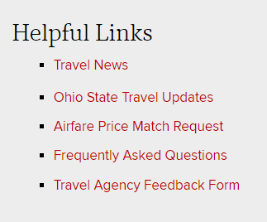
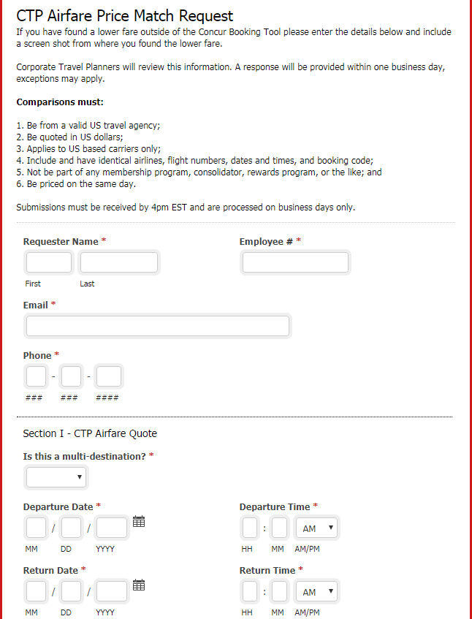
Travel Office Resources
Website (go.osu.edu/travel-office)
Notes:
Helpful Links include: News with a variety of industry and internal news options
Airfare Price Comparison Request
Must be completed in full; provide screenshot and submit online.
Submissions must be received by 4pm EST and are processed on business days only.
A response will be provided within one business day, exceptions may apply.

Slide 3
Travel Office Resources
Website (go.osu.edu/travel-office)
FAQ & Best Practices
Notes:
Utilize the FAQ and Best Practices link when unable to find specific references in policy.

Slide 4
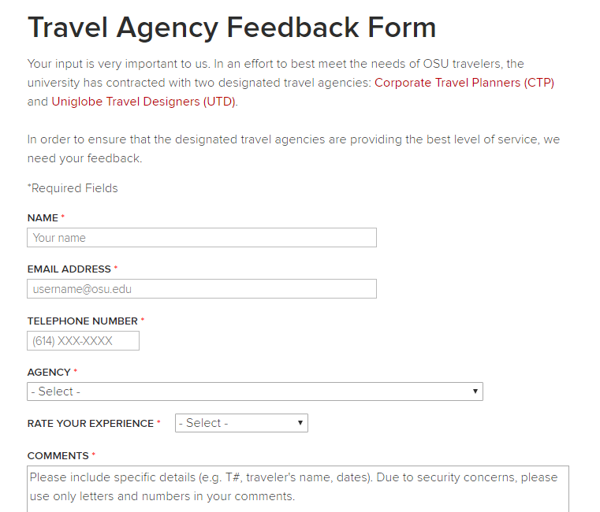
Travel Office Resources
Website (go.osu.edu/travel-office)
Notes:
Use the Feedback Form to share experience with either travel agency. For time sensitive questions/issues, route directly to travel@osu.edu.

Slide 5
Travel Reminders (eTravel)
Airfare Quotes
An “official” airfare quote is not required to generate the T#
Efficiencies gained by entering a reasonable estimate for submission
Gather Air $ Estimate
Create/Submit Travel Request
Approve
(T#)
Finalize Airfare Selection
Provide T# to Purchase
Notes:
Feedback from users suggest that there are significant delays in entering the travel request and approvals results in duplicate efforts and lost fares.
Best Practice Recommendation: Simply enter a reasonable amount with the rest of the estimates, generate the T# and allow user to purchase at time of search.
Traveler/Arranger will receive email with the estimate and T#, along with helpful links to Travel Office Website to begin airfare search/purchase process.

Slide 6
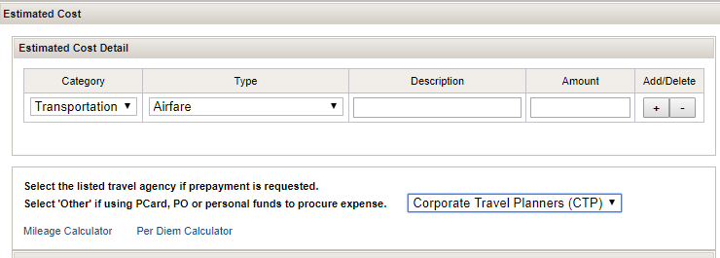
Travel Reminders (eTravel)
Agency Selection
Select appropriate airfare payment method (Travel Agency or Other).
Notes:
When Airfare is selected as transportation type.
Travel Agency (CTP) – Prepayment
Other – Personal Funds
Why this is important? – reporting for compliance

Slide 7
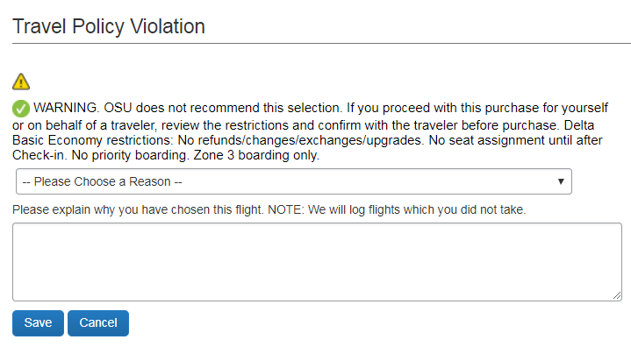
Travel Reminders (Booking)
Basic Economy Fares
Highly restrictive fares (Delta, American, United, Air Canada)
Warning in Concur
Acknowledgement of selection required
Traveler notified to allow for 24 hour cancellation
Notes:
Highly restrictive fares sold on Delta, American, United
Cannot be changed
No value if cancelled
No Assigned Seating
No overhead bin use
Policy does not prohibit and on occasion they are workable for some travelers; but The Travel Office does not recommend purchasing these fares due to their significant restrictions.
Why in Concur? Accessible in Concur to display all possible flight options available through Airline websites.
Concur has policy rule in place to trigger acknowledgement by user of known restrictions.
Email will go to traveler upon purchase to confirm that traveler is aware of limitations prior to travel; 24 cancellation window only.

Slide 8
Travel Initiative
Scope of Travel Initiative:
Airfare
Enterprise-wide requirement of 1 travel agency for individual business travel
Corporate Travel Planners
Rental Car
Enterprise-wide requirement of 1 rental car contract for business travel
Enterprise & National
Notes:
Scope of the travel initiative is inclusive to airfare and rental car services

Slide 9
Travel Initiative
Things to Know…
Not required for guests (non-employees)
Personal credit card can be used with CTP in Concur
Split transactions for business/vacation
Does not include hotel
Risks of bundled & hacker fares (e.g. Kayak)
Voucher Drawing (1/mo for 1st year of Travel Initiative)
Notes:
Encouraged, but not required for guests (non-employees)
Personal credit card can be used with CTP in Concur for business use only – no personal travel
Split transactions for business/leisure must be coordinated through a full service agent
Does not include hotel
Risks of bundled & hacker fares (e.g. Kayak) - KAYAK plays airfare matchmaker by finding two one-way tickets that together make a round-trip flight. Sometimes that means you might take a different airline home than the one you took to your destination. Problems can arise with International flights or those with connections that would not be re-accommodated by the airline with delays or cancellations.
Voucher Drawing (1/month for 1st year of Travel Initiative) – 3 issued during Pilot II

Slide 10
Travel Initiative
Next Steps…
Training Schedule - Classroom, Online and Custom Skype
Agency Feedback Process - In development - Coming Soon
Compliance Reporting - In development - Coming Soon
Release Travel Policy - In review - Coming Soon
Requirements and enforcement
Vacation with business travel
Prohibit PCard use for airfare
Airfare itinerary/invoice – must be attached to T#
Update to discussion on 6/14 10 a.m. – travelers permitted 2 strikes; activation of process TBD
Notes:
Training Schedule under development as we look to secure locations. Communication for training will be released through NewsLink and will always be available in BuckeyeLearn. Additional communication will be released to the SBOs and SC managers.
Feedback Process Feedback, Issue reporting and other consultation will be gathered in a new system similar to Service Now
Compliance Reporting for easy determination of how your unit is performing under the initiative is under development – reliant on eTravel system to differentiate airfare not procured through CTP
Travel Policy
Proposed changes include:
From strongly encouraged to required for airfare purchases with CTP – Individual Business Travel
Enforcement of the initiative will allow for 2 strikes; controlled through compliance approval in the eTravel system by the travel office
Required to procure rental services from Enterprise and National under OSU contract
Process to segregate payment when blending business/leisure travel (e.g. split transaction with CTP or recovered by personal check within 2 business days); must have comparison before purchase occurs
Prohibit airfare purchased with a PCard – resource provided through CTP and OSU ghost card
Include CTP itinerary/invoice as attachment in eTravel – this is provided with each transaction by email

