Slide 1



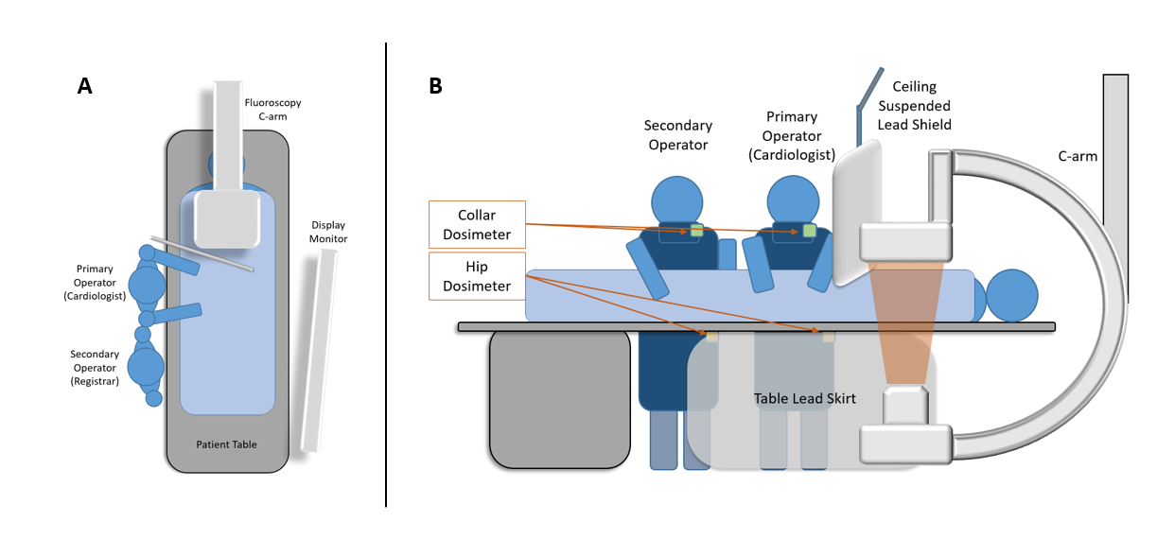
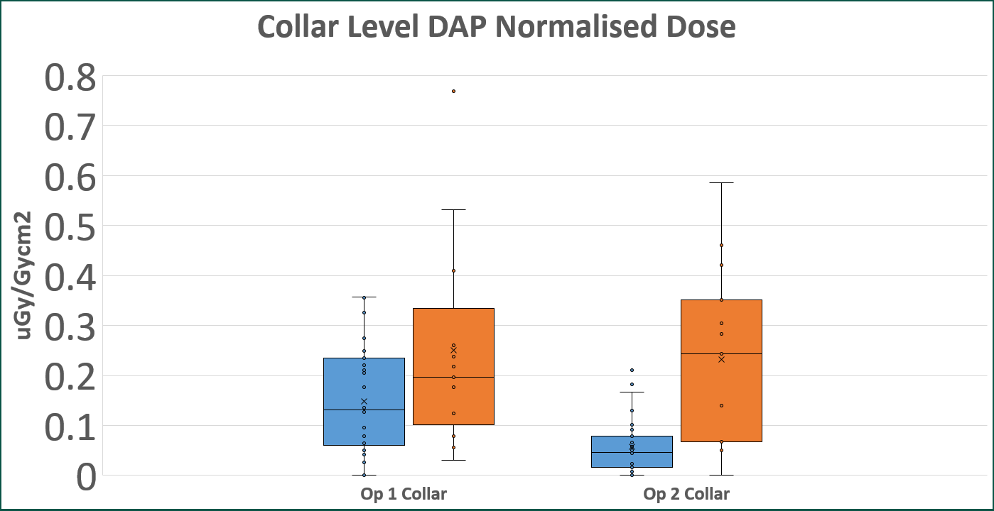
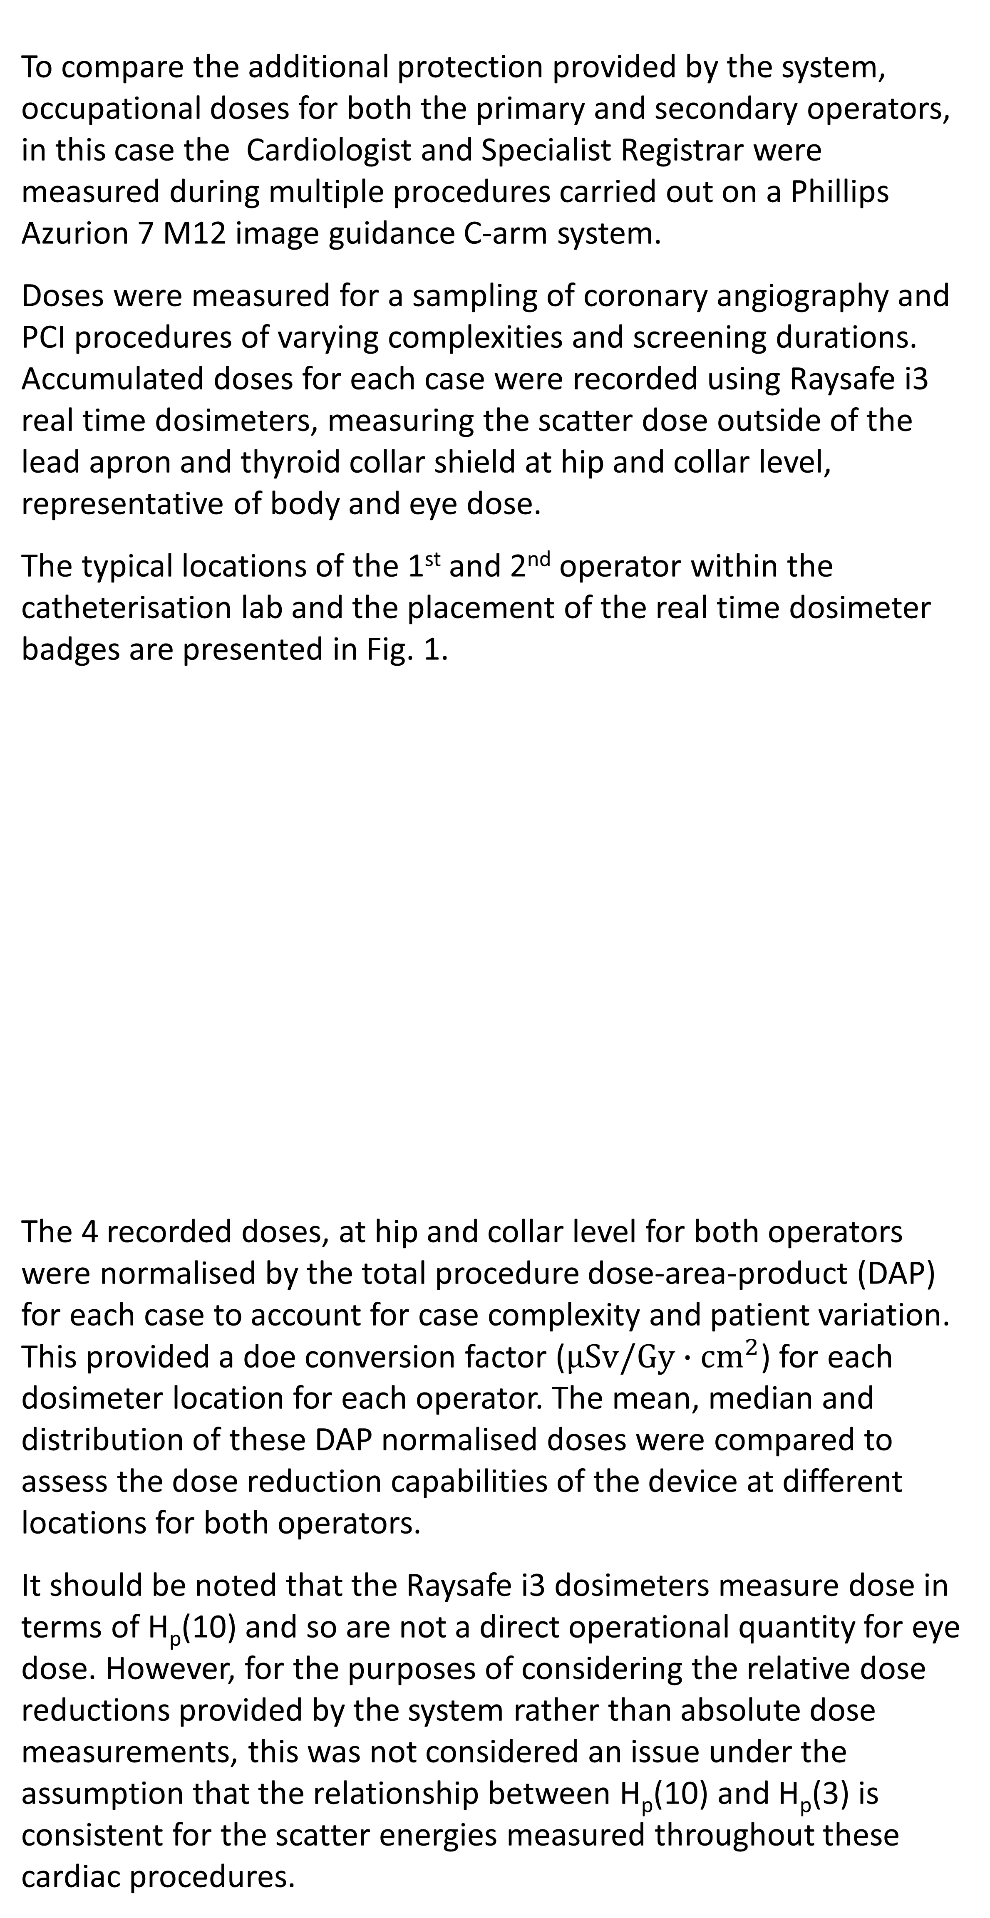
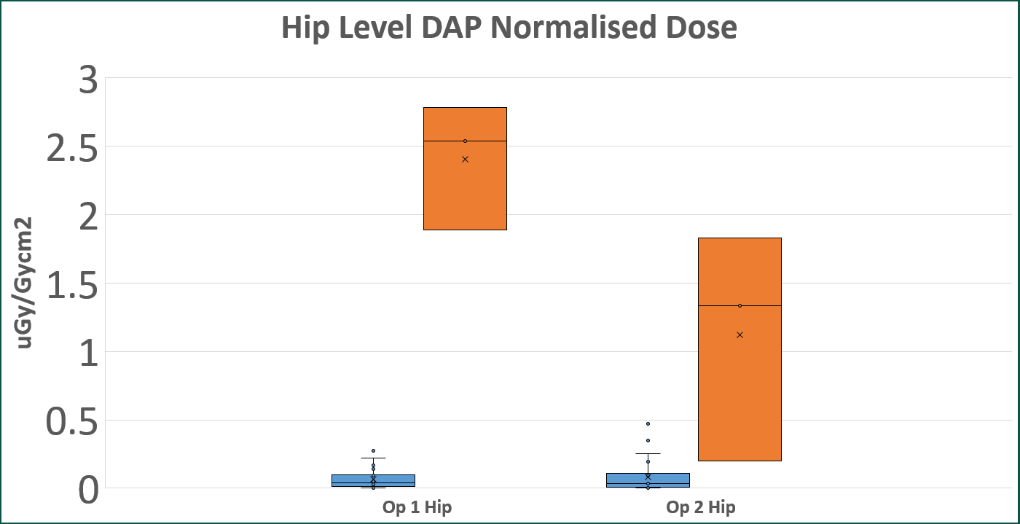
Evaluation of the Nest Egg radiation protection device in a cardiac catheterisation lab
Keith Scully¹, Eilís O’Halloran¹, Emerald House¹
1. Department of Medical Physics and Clinical Engineering, University Hospital Galway
Introduction
Results
Cardiologists are of particular interest in the monitoring of occupational radiation exposure doses due to their relatively close proximity to the patient, the source of scatter, coupled with generally high workload procedures.
This work compares the scatter protection provided by a 360º, whole room, radiation protection device with that of standard shielding. The standard room shielding consists of the table lead skirts and a ceiling suspended lead screen. The added protection device consists of a carbon fibre base secured to the patient couch from which flexible shielding skirts wrap the patient couch and retractable flip shielding side panels along the side and around head of the patient bed provide additional scatter shielding.
The dose distributions for both operators at collar and hip level, with and without the additional shielding, are presented in Fig. 2. and Fig. 3.
Table 1. shows the percentage reduction in the average and median DAP normalised doses for cases with and without the shielding device in place.
A greater than 95% dose reduction was observed for the primary operator at hip level and over 80% reduction for the secondary operator. The collar level reduction was greater than 70% for the secondary operator. The measured reduction in collar level doses for the primary operator was less significant, approximately 41% reduction in the average and 33% reduction in the median doses.
Methodology
To compare the additional protection provided by the system, occupational doses for both the primary and secondary operators, in this case the Cardiologist and Specialist Registrar were measured during multiple procedures carried out on a Phillips Azurion 7 M12 image guidance C-arm system.
Doses were measured for a sampling of coronary angiography and PCI procedures of varying complexities and screening durations. Accumulated doses for each case were recorded using Raysafe i3 real time dosimeters, measuring the scatter dose outside of the lead apron and thyroid collar shield at hip and collar level, representative of body and eye dose.
The typical locations of the 1st and 2nd operator within the catheterisation lab and the placement of the real time dosimeter badges are presented in Fig. 1.
The 4 recorded doses, at hip and collar level for both operators were normalised by the total procedure dose-area-product (DAP) for each case to account for case complexity and patient variation. This provided a doe conversion factor ($μSv/Gy∙{cm}^{2}$) for each dosimeter location for each operator. The mean, median and distribution of these DAP normalised doses were compared to assess the dose reduction capabilities of the device at different locations for both operators.
It should be noted that the Raysafe i3 dosimeters measure dose in terms of H_{p}(10) and so are not a direct operational quantity for eye dose. However, for the purposes of considering the relative dose reductions provided by the system rather than absolute dose measurements, this was not considered an issue under the assumption that the relationship between H_{p}(10) and H_{p}(3) is consistent for the scatter energies measured throughout these cardiac procedures.
Fig. 2. Boxplots showing the distribution of normalised dose distributions measured at collar level for the primary and secondary operator, for cases with and without the protection device in the place.
Fig. 3. Boxplots showing the distribution of normalised dose distributions measured at hip level for the primary and secondary operator, for cases with and without the protection device in the place.
 | Primary Operator Hip Level | Primary Operator Collar Level | Secondary Operator Hip Level | Secondary Operator Collar Level
% Reduction in Mean Dose/Dap | 96.4 % | 41.2 % | 86.5 % | 75.2 %
% Reduction in Median Dose/Dap | 98 % | 33.3 % | 83.7 % | 81.1 %
Fig. 2. Diagrams showing plan view of operator positions during a Cath lab case (A) and Side view showing operator positions along with C-arm, real time dosimeters and standard shielding protection (B).
Table 1. Percentage reductions in the measured mean and median normalised dose values at hip and collar levels for the primary and secondary operator.
Conclusion
This work highlights the potential dose reductions that can be achieved using this device, but with a strong dependency on the correct use of existing shielding. The potential eye dose reductions are likely more significant, particularly for the secondary operator. Body doses, as measured at hip level, would be heavily attenuated by the user’s lead apron, meaning the high relative dose reductions at those areas would translate into less of an effect in absolute dose terms.

