Slide 1
Columbus-Athens Schweitzer Fellows Program

Slide 2
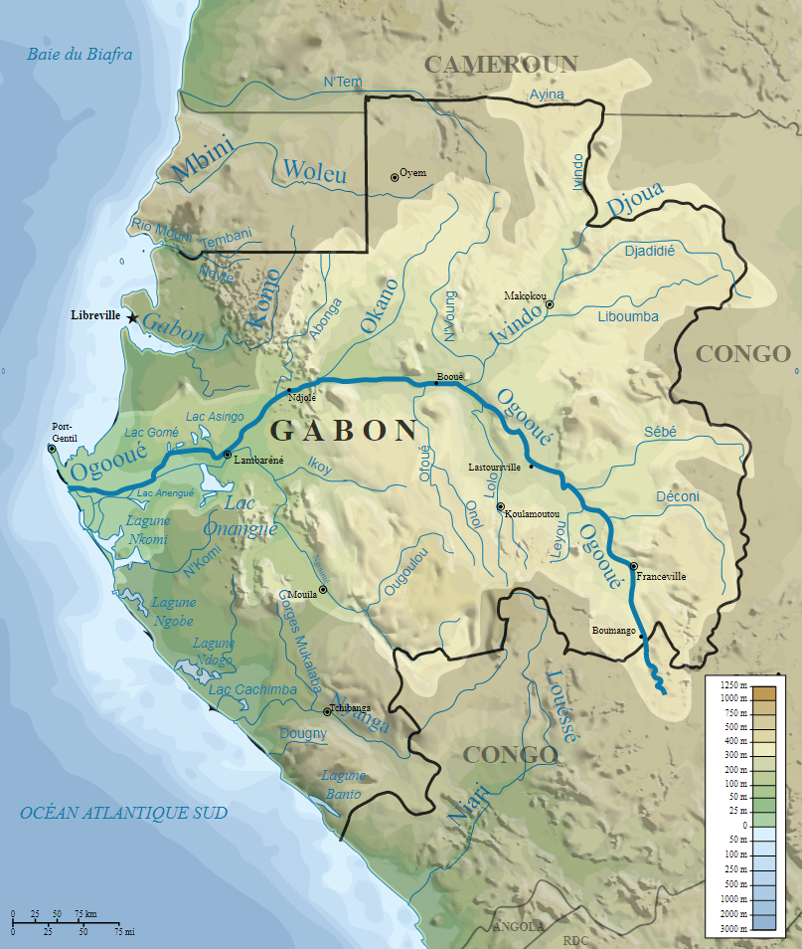
Who was Albert Schweitzer?
French-German theologian, organist, writer, humanitarian, philosopher, and physician
Received the 1952 Nobel Peace Prize
Medical doctor / missionary
Founded the Albert Schweitzer Hospital in Lambaréné (now in Gabon)
(14 Jan 1875 - 4 Sept 1965)
Lambaréné
~200 miles (14 days by raft) upstream from the mouth of the Ogooué at Port Gentil

Slide 3
Albert Schweitzer Fellowship
Founded in 1940 by Schweitzer to unite U.S. supporters of his hospital its European supply lines was cut off by the war.
Lambaréné Hospital was just “…my own improvisation on the theme of Reverence for Life. Everyone can have their own Lambaréné." - Albert Schweitzer
The U.S. Schweitzer Fellows Program launched in 1991
Supports and trains emerging health-focused graduate and professional students in creating and carrying out yearlong service projects that address unmet community needs
Young Americans in health-related professional fields find or create "their own Lambaréné" in the US or internationally

Slide 4
Columbus – Athens Schweitzer Fellows Program
Chapter began in September 2010 and was funded by a consortium of partners:
Heritage College of Osteopathic Medicine
College of Health Sciences and Professions
The Gladys W. & David H. Patton College of Education
Office of Outreach & Engagement
College of Arts & Sciences
College of Dentistry
College of Education and Human Ecology Fisher College of Business College of Medicine College of Nursing College of Optometry College of Pharmacy College of Public Health College of Social Work College of Veterinary Medicine

Slide 5
Columbus – Athens Schweitzer Fellows Program Goals
To provide skilled and compassionate direct services that address important unmet needs of local underserved individuals and communities;
To support and train emerging professional leaders in ways that strengthen their commitment to, and skills in, public service;
To develop a pipeline of emerging professionals with the capacity to effect change in the social and health care systems that will reduce and ultimately eliminate disparities impacting people’s health and lives.

Slide 6
“Being a Fellow is not just a 12-month, one-service-project deal; it is a lifelong commitment and mission. It has reminded me that school is not all about scholarships, credentials and grades, but about being agents of change.”
- Tessa Yoder, Columbus-Athens Schweitzer Fellow

Slide 7
What will the 2018-2019 Fellows do?
Design and carry out projects
>200 hours of service in partnership with an existing community agency and under the supervision of an academic and community-based mentor
Of these 200 hours, at least 150 hours should consist of direct client contact with an emphasis placed on activities that will have an enduring benefit to the agency
Receive $3,000 stipend
Participate in reflective leadership development programming
Participate in orientation
Attend monthly meetings and submit monthly reports
Site visits from co-directors
Possibly attend the SPARK! Gala & Conference in Boston in October
Present at the end-of-year Celebration of Service

Slide 8
Fellows for Life
Fellows for Life alumni national network now includes more than 3,000 physicians, nurses, lawyers, public health specialists, social workers, pharmacists, occupational therapists, and other leaders in health-related fields.
ASF supports our alumni by providing opportunities for them to continue to network and inspire one another as well as participate in service projects and learn from experts in the field.
Goal is to perpetuate Dr. Schweitzer’s legacy of humanitarian service.
To develop leaders in service.

Slide 9
Applications
Apply online through the Columbus-Athens ASF website:
http://www.schweitzerfellowship.org/chapters/columbus/
Applications due Tuesday, February 13, 2018

Slide 10
Eligibility
Be enrolled in 2018-2019 in a graduate or professional degree-granting program from any accredited academic institution in the Columbus-Athens area
Propose a community service project to provide direct service to an underserved population
Project should address a need of a local community related to health or social determinants of health
Research, fundraising/administrative, and policy-based projects are not eligible
Identify a local community agency partner and a faculty mentor
Agree to attend orientation on Saturday, April 14, 2018 and the Celebration of Service in May 2019

Slide 11
Advice
Think broadly about health as a state of complete physical, mental and social well-being and not merely the absence of disease or infirmity. Projects can target not only clinical health issues, but also can address many community issues that affect one’s health and well-being.
Meet with community partner to ensure that project addresses a community need.
Think through the ways in which you own energies and talents might contribute, even in small ways, to ameliorating a community need.
Review past Fellows’ projects and partners for ideas.
Be creative!

Slide 12
Questions?
For more information, contact
Drs. Lizzie Fitzgerald and Maria Gallo
at Columbus-AthensASF@osu.edu

