Slide 1
Integrated fulfillment options
Link directly to online full text through the WorldCat knowledge base or a local OpenURL resolver
Borrow from another library* Built-in user-initiated interlibrary loan
Link directly to your OPAC for availability
Buy items directly from content providers
* For libraries with an interlibrary loan subscription
Notes:
In addition to discovery, WorldCat Discovery also provides the ability for searchers to borrow, buy or connect to full text. Users choose the preferred content delivery method: link to full text, borrow from another library through interlibrary loan, link directly to your OPAC or buy items directly from content providers. If you subscribe to OCLC Resource Sharing and use WorldShare ILL or ILLiad, you can use the service to support user-initiated ILL requests as you have in FirstSearch for many years.

Slide 2
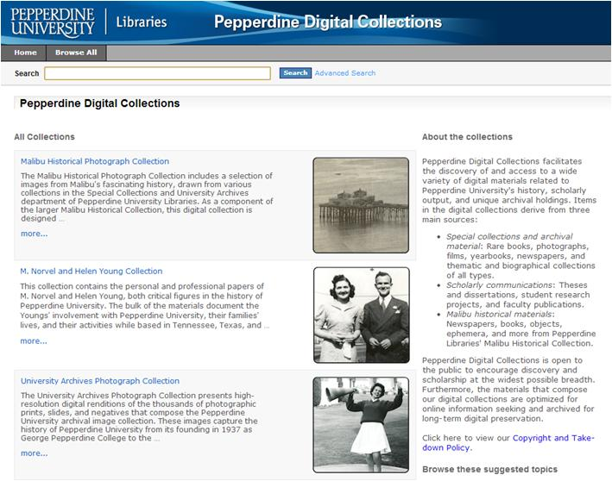
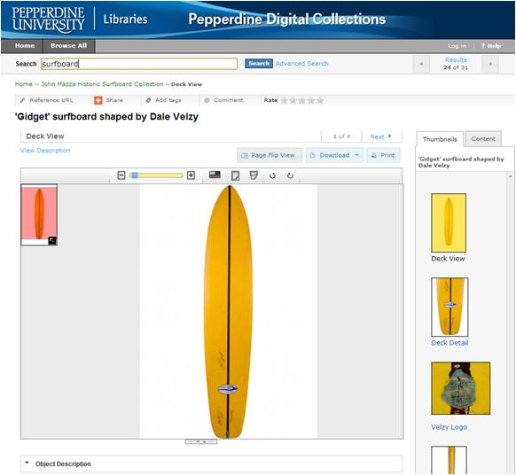
Feature your digital collections online with CONTENTdm “quick start”
To get started, visit: http://oc.lc/contentdm.quickstart
Notes:
With your WorldCat Discovery Services subscription, you’ll also receive CONTENTdm “quick start” to help you manage your library’s digital collections and make them available on the Web. This option is included in your WorldCat Discovery subscription at no additional charge to help your library make its digital content available to more people.
CONTENTdm “quick start” includes:
The CONTENTdm software hosted by OCLC
Three Project Clients for building your digital collections
10GB of storage for up to 3,000 digital items
To get started, visit the CONTENTdm “quick start” website.

Slide 3
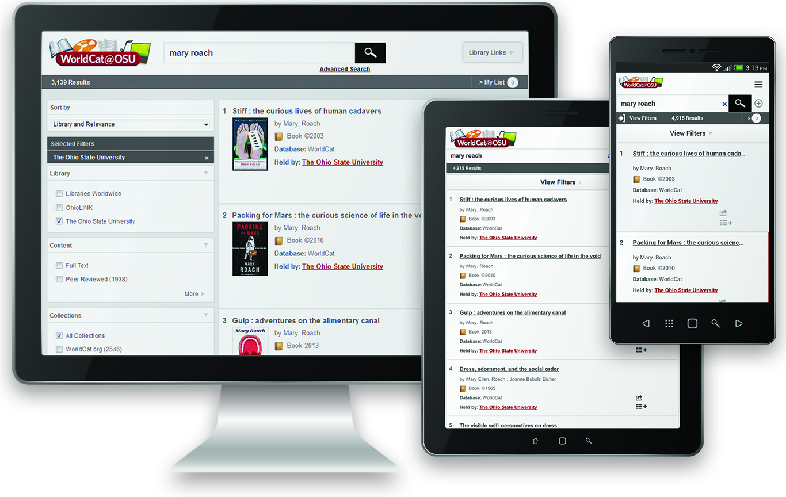
New discovery experience
Notes:
WorldCat Discovery Services deliver an enhanced interface that meets end user expectations, while maintaining the expert capabilities researchers and library staff require. The interface is device-independent and optimized for use across desktops, laptops, tablets and smartphones.
Your library will receive its own URL for the service. It is through your library-specific URL that your users will access your site. You may customize your site with your library’s logo or brand colors, to reinforce your library’s identity to its users. Access through your library’s URL, using IP address recognition, will replace your current FirstSearch logon that requires use of a 9-digit authorization and password.
If you subscribe to OCLC cataloging, then WorldCat knows what’s in your local library collections, so we can display your library’s resources at the top of search results.

Slide 4
Get Ready for WorldCat Discovery
Update your OPAC link and IP address information in the WorldCat Registry
Make sure your library’s WorldCat holdings are up-to-date
Request access to the WorldCat knowledge base and add local data
Identify your subscription (licensed) database content
Attend a “Getting Ready for WorldCat Discovery webinar http://oc.lc/getreadywebinars
Register for email updates at
www.oclc.org/en-US/email.html
Notes:
There are several things you can do to prepare for WorldCat Discovery Services.
-Review and update your library’s OPAC link and IP address information in the WorldCat Registry. This information will increase the effectiveness of your use of WorldCat Discovery.
Make sure your library’s holdings are up-to-date in WorldCat. Your library’s WorldCat holdings maximize the benefits your library will receive from the service. The OPAC link data enables the services to connect with your OPAC for availability information. IP addresses are required for user access to WorldCat Discovery.
Request access to the WorldCat knowledge base. If you have not already populated the WorldCat knowledge base with your local library data, this is a good time to do so. It is knowledge base data that enables WorldCat Discovery users to connect from citations to full-text resources to which your library subscribes.
Make a list of your library’s subscriptions to licensed content collections. With this list in hand, you can quickly enable direct links to full text from results lists.
Attend a Webinar. At these webinars, you’ll learn how to get ready NOW, to make your transition really easy. www.oclc.org/go/en/worldcat-discovery.html
But first and foremost, sign up to receive WorldCat e-mail updates and the FirstSearch listserv to stay up-to-date about WorldCat Discovery announcements.
Then think about when your library might want to transition over the next 12 months.

Slide 5
Notes:
One of your requests was for an update on the WorldShare Cataloging module and that is what I’ll provide now. The overall product is called WorldShare metadata, and it has two major components. You may use one or the other or both.

Slide 6
Provides a single integrated set of management services for libraries to improve visibility and efficiency, including services from OCLC, partners and libraries
Notes:
Within the WorldShare interface, the new Metadata application lives right next to Acquisitions, Licenses, Circulation, and Interlibrary Loan. On the left, you can see the Metadata functionality including Manage Records, Manage Collections, and access to My Apps that we created via the WorldShare Platform. This interface provides a single integrated set of management services for libraries to improve visibility and efficiency, including services from OCLC, partners and libraries.

Slide 7
OCLC WorldShare Metadata Record Manager
Create and replace WorldCat® master records using either the MARC 21 editor or the Text View editor, a simplified, labeled interface
Set and delete WorldCat holdings
Manage local holdings records (LHRs) and local bibliographic data (LBD)
Save in-progress bibliographic records for later use
Search and display Library of Congress authority records
Incorporate auto-suggest FAST subject headings using the Text View editor
Export bibliographic records via TCP/IP connection to your local system
Currently available to WMS libraries; will be available to early adopters later in 2014
There is no end of life date for Connexion
Notes:
Record Manager will support record by record cataloging, where you can create new or enrich existing WorldCat records, manage WorldCat holdings, and other cataloging functionality. It is currently available to WMS libraries, and it will be available to early adopters that are not WMS libraries later this year. You can see on the screen a list of all the things one can do with Record Manager. Please note that there is no end of life date for Connexion.

Slide 8
OCLC WorldShare Metadata Collection Manager
WorldShare Metadata Collection Manager automatically delivers and updates WorldCat MARC records and maintains WorldCat holdings for all or subsets of your collection.
The service ensures that the bibliographic metadata for all materials and access URLs for e-content are continually updated in your discovery interface.
Your users get better access, your staff gains time for other priorities, and you see improved return on the investments you have made in your collections.
WorldShare Metadata Collection Manager is the ideal solution for streamlining workflows while managing increased user demand for e-content.
Notes:
The second major component of WorldShare metadata is Collection Manager. This is a great service, and I recommend that if you work with or subscribe to any sets of records, that you investigate how this can benefit you right now.

Slide 9
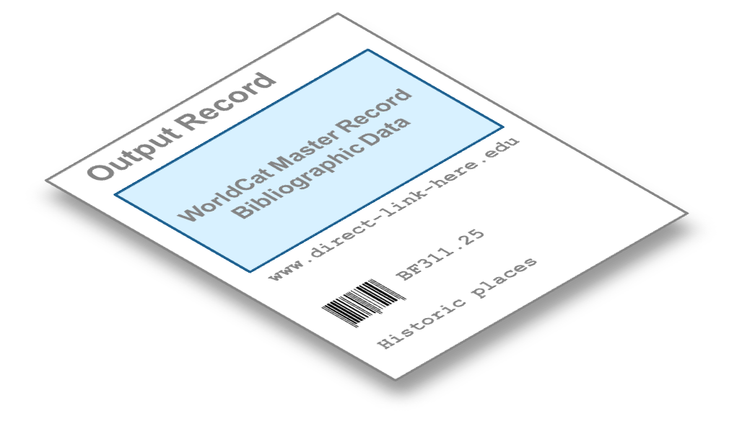
new records…
updates…
deletes…
and holdings
WorldShare Metadata Collection Manager
Registration…
knowledge base
holdings
WorldCat Master Record
Bibliographic Data
Output Record 1
Additional metadata
www.my-url-here.edu
www.my-2nd-URL.edu
My call number
My local subject
Notes:
A few years back, OCLC introduced the WorldCat knowledge base to help libraries register and manage their E collections. In August 2012, WorldShare Metadata Collection Manager was introduced to build additional functionality such as output of MARC records to help patrons discover library E collections in local catalogs and discovery systems. Let’s take a look at how the service works.
First, you register your collections in the knowledge base. OCLC then updates the collections based on metadata provided by partners. We compare each data feed to determine what new titles are now available to you and provide MARC records if desired. We also monitor for changes and deliver updated records when either your URLs change or the WorldCat master record has been enriched by the cataloging community. We also notify you of any titles that have been removed from your collection. WorldCat holdings are automatically maintained, both adding holdings for new titles and deleting holdings from removed titles.

Slide 10
WorldCat knowledge base standard collections
Over 11,000 content collections from nearly 6,000 providers
Over 50 publishers and aggregators representing 13M E books including:
Books24x7
DawsonEra
Ebook Library (EBL)
EBSCO
ebrary
Ingram MyiLibrary
Knovel Library
Safari Books Online
Springer
Informa Taylor & Francis
Wiley

Slide 11
Knowledge base
Previously…
5,600 + providers
knowledge base
Notes:
The knowledge base includes collections from over 5,600 providers. In some cases, you might purchase E-books title by title instead of collection by collection. EBL and ebrary currently provide OCLC with your specific title list so that we can register your collection automatically. And if you have a Demand Driven Acquisitions plan, we can separate the collections between DDA titles and purchased titles. We’ve also implemented specific library collections based on US government documents, and most recently we implemented library-specific E collections from Ingram.
Previously, OCLC received the provider data, loaded it into the knowledge base, and it automatically went to the libraries that have registered the specific collection.

Slide 12
Knowledge base cooperative data management
New – Phase 1
5,600 + providers
knowledge base
1. Member libraries approve/deny changes before they are made.
Notes:
As we talked with the knowledge base community, we found that individual libraries were making changes to the metadata one library at a time, each duplicating effort. With WorldCat, the library community manages the bibliographic metadata cooperatively so that each library can benefit from the work of others. Why not take this same approach with the knowledge base data? This lead to our new knowledge base cooperative data management functionality that is being implemented in multiple phases. With the first phase that was implemented last March, the community has a chance to review the changes to the collection and either approve or deny them before they are distributed to all libraries registered for the collection.

Slide 13
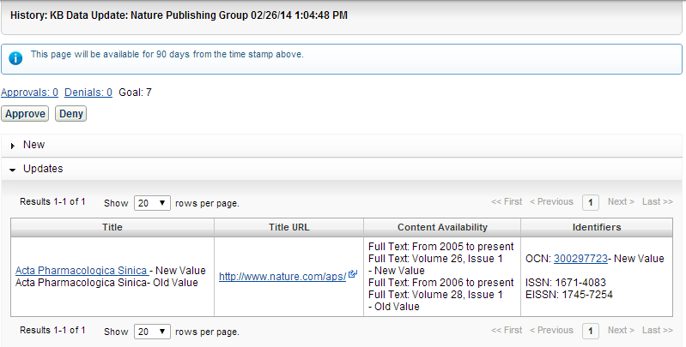
Powered by library cooperation
See changes to global KB collections before they are applied

Slide 14
Knowledge base cooperative data management
New – Phase 2
5,600 + providers
knowledge base
2. Members can make changes to existing knowledge base records
Notes:
In the second phase, which OCLC implemented last May, libraries are able to update the metadata associated with titles in the existing collections. If you notice that an ISBN needs to be updated, you can update and submit it to the global knowledge base so that all libraries can benefit from your work and you can benefit from updates from others. Modifications also go through the approval process that I mentioned previously.

Slide 15
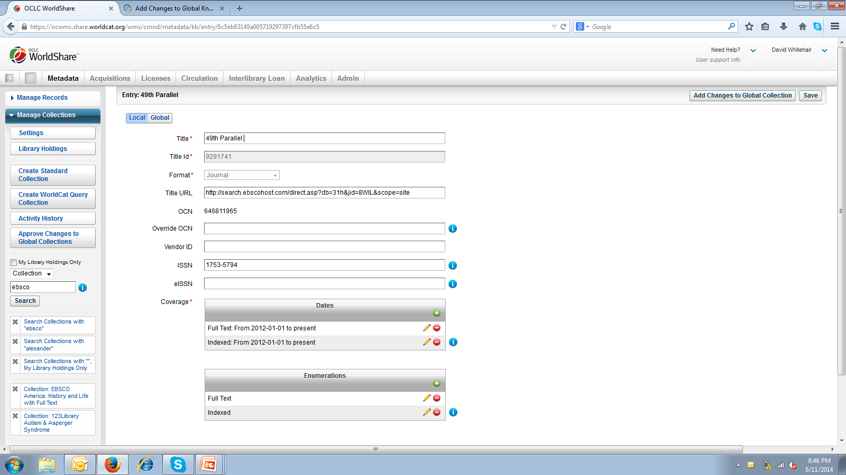
Powered by library cooperation
Edit existing records and submit to global collection

Slide 16
Knowledge base cooperative data management
Soon – Phase 3
5,600 + providers
knowledge base
3. Members can add new records
and new collections.
Notes:
In the third phase which is coming soon, you will be able to add new titles to existing collections and also add new collections that you want to share with the community. We are very excited about this new cooperative data management of the knowledge base data, and we will be announcing more information in the coming months. We look forward to receiving your input as you begin using the new functionality.

Slide 17
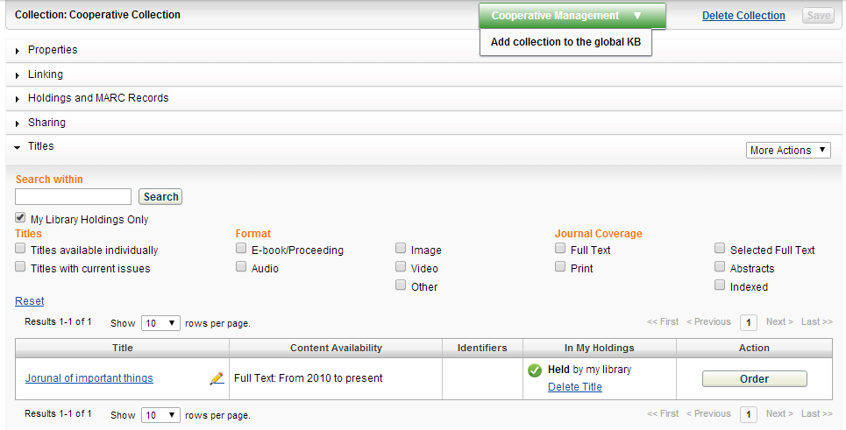
Powered by library cooperation

Slide 18
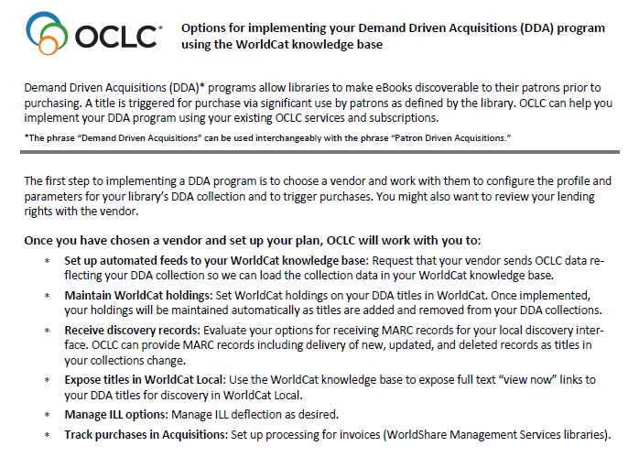
http://www.oclc.org/content/dam/support/knowledge-base/oclc_dda.pdf
Notes:
Library specific holdings, especially to support DDA. Currently supported with EBL and ebrary. New document outlining how you can use the KB to support. Other providers coming in the future.

