Slide 1
June 24, 2014
Las Vegas
OCLC Update
Cynthia M. Whitacre
Manager, WorldCat Quality & Partner Content Dept.

Slide 2
Agenda
General update including VIAF and FAST
WorldCat Discovery
WorldShare Metadata and the WorldCat knowledge base
Questions and answers

Slide 4
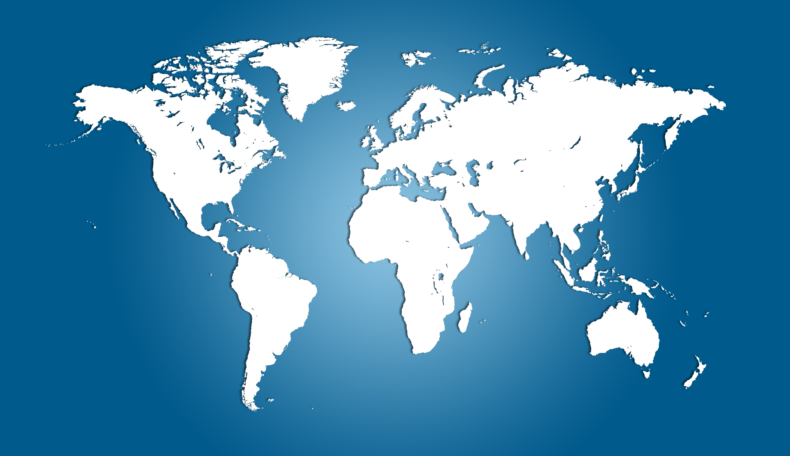
72,000 libraries in 170 countries
1,418
5,715
4,058
55,820
1,752
1,091
1,800
381

Slide 5
WorldCat Top 10 Languages: April 2014
English | eng | 124,195,894
German | ger | 40,713,789
Undetermined | und | 34,719,441
French | fre | 28,791,547
Spanish | spa | 14,295,842
Chinese | chi | 9,561,260
Japanese | jpn | 9,431,318
Italian | ita | 6,386,890
Dutch | dut | 4,950,474
No linguistic content | zxx | 4,704,024
Notes:
These are of course the language of the item that is recorded in 008 or fixed field.

Slide 6
WorldCat Next 10 Languages: April 2014
Latin | lat | 4,159,494
Russian | rus | 3,942,144
Polish | pol | 3,717,411
Danish | dan | 3,009,029
Portuguese | por | 2,488,042
Swedish | swe | 2,327,734
Hebrew | heb | 1,963,980
Slovenian | slv | 1,945,702
Arabic | ara | 1,516,810
Czech | cze | 1,434,854
Notes:
You’ll notice that Hebrew is 17th on the list.
The total number of records in WorldCat as of April 2014 when these statistics were pulled was 317,212,857

Slide 7
Non-Latin scripts in WorldCat
 | June 2014 | 6 month growth | 5 year growth
Arabic | 944,363 | 4.04% | 137.80%
Armenian* | 2,115 | 23.76%
Bengali | 1,153 | 31.77% | 822.40%
CJK | 18,416,307 | 4.15% | 175.63%
Cyrillic | 880,391 | 4.55% | 289.28%
Devanagari | 7,626 | 13.99% | 1522.55%
Ethiopic* | 39 | 105.26%
Greek** | 101,807 | -38.43% | 2243.62%
Hebrew | 1,950,409 | 13.64% | 100.10%
Syriac* | 1 | 100%
Tamil | 56,719 | 1.67% | 353.75%
Thai | 569,199 | 38.42% | 60842.08%
Notes:
Aremenian, Ethiopic and Syriac scripts were added in November 2013, so they are new to this chart.
The 1 record with Syriac script is from the National Library of Israel.
**During the past 6 months, QC staff members have corrected a large number of records in which incorrectly used characters were causing the records to be identified as Greek.

Slide 8
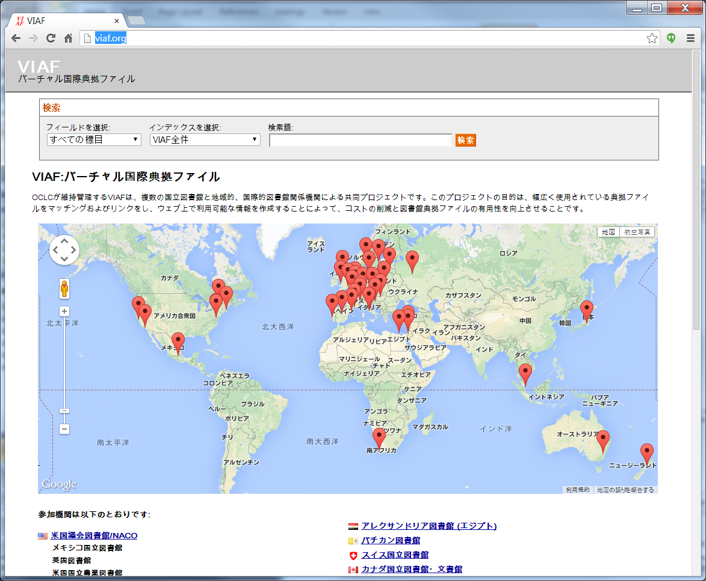
VIAF – by the numbers
Contributors:
34 Agencies
28 Countries
23 National libraries*
+10 via consortia
15 Agencies joined in 2012-2013
Now working with ISNI & Wikipedia
* National Library of Israel is a participant
More about VIAF
viaf@oclc.org
Background information
http://www.oclc.org/en-US/viaf.htm
VIAF web interface
http://www.viaf.org
Information about the VIAF API
http://www.oclc.org/developer/services/virtual-international-authority-file-viaf
l
VIAF supplies interfaces in various languages based on recognizing the language associated with the user’s browser.
Notes:
You see this map showing current VIAF contributors when you go to the VIAF web site, viaf.org. You’re seeing it in the context of the Japanese interface. VIAF supplies interfaces in various languages based on recognizing the language associated with the user’s browser.
VIAF is now cooperating with ISNI (the International Standard Name Identifier) and with Wikipedia to incorporate data from those sources into VIAF and to make links from Wikipedia to VIAF.
In addition to ~ 34 million authorities, we also process ~107 associated million bibliographic records to find titles of resources, coauthors, publication dates, publishers, and other data to assist in the VIAF matching process.

Slide 9
FAST (Faceted Application of Subject Terminology)
Joint OCLC Research and Library of Congress project
Provides a faceted version of the Library of Congress Subject Headings
Available in various interfaces and downloadable versions
http://fast.oclc.org/searchfast/
Notes:
FAST is…. FAST (Faceted Application of Subject Terminology) is a fully enumerative faceted subject
heading schema derived from the Library of Congress Subject Headings (LCSH). Development of FAST was a collaboration of OCLC and LC, with advice from the ALCTS CaMMS Subject Analysis Committee Subcommittee on FAST.
If you go to the URL at the bottom of this slide, you can search fast online.

Slide 10
8 categories of facets
FAST Facet | MARC 21 field
Chronological | 648
Corporate Names | 610
Events | 611
Form/Genre | 655
Geographic Names | 651
Personal Names | 600
Titles | 630
Topics | 650
Notes:
These are the MARC 21 tags in which FAST will appear in bibliographic records.

Slide 11
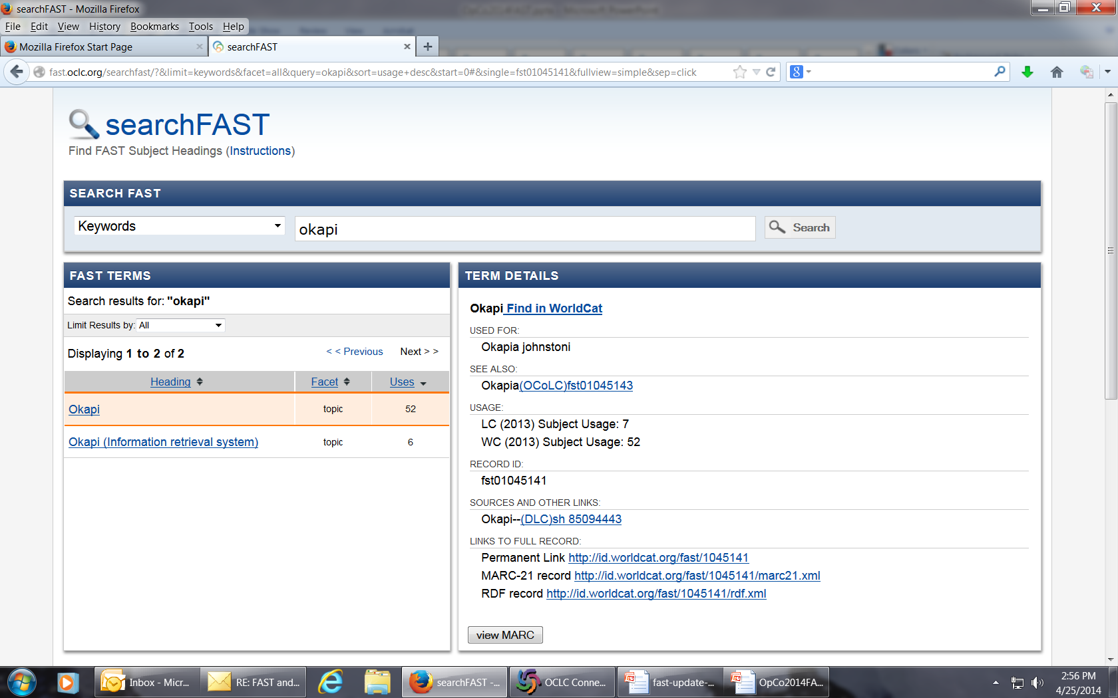
Notes:
Here’s a search interface for FAST showing the result list from a search for “okapi” as a keyword. Note that if you click on the “view MARC” button at the bottom of the slide you can view the MARC authority record for the fast heading.

Slide 12
FAST authority record
LDR00000cz a2200037n 45 0
001 fst01045141
003 OCoLC
005 20090914163117.0
008 041024nn anznnbabn || ana d
016 7_$a fst01045141$2 OCoLC
040 __$a OCoLC$b eng$c OCoLC$f fast
053 _0$a QL737.U56
150 __$a Okapi
450 __$a Okapia johnstoni
550 __$a Okapia$0 (OCoLC)fst01045143
688 __$a LC (2013) Subject Usage: 7
688 __$a WC (2013) Subject Usage: 52
750 _0$a Okapi$0 (DLC)sh 85094443
Notes:
And, here is that MARC authority record. The subfield zeros in the 550 and 750 are links.

Slide 13
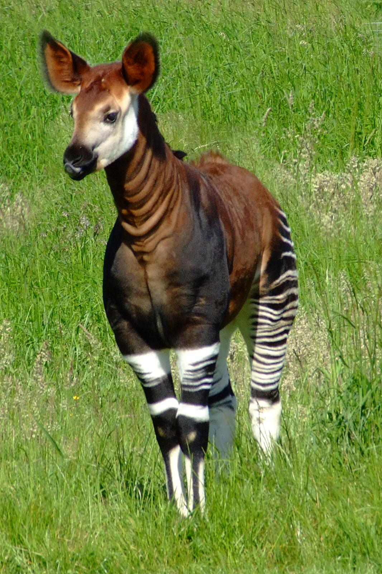
Here’s an Okapi – a very interesting animal – known as a zebra giraffe.
650 _7 ǂa Okapi. ǂ2 fast ǂ0 (OCoLC)fst01045141
Picture credit: Wikipedia
Notes:
And, because it always is nice to have great picture, I thought I’d provide this illustration. And, this shows you how a FAST heading is formulated for use in a MARC bibliographic record.

Slide 14
FAST (Faceted Application of Subject Terminology)
Benefits
Simple to learn and apply
Designed to facilitate faceted navigation
Modern in its design (for example, useable in a linked data environment)
Background on FAST
http://www.oclc.org/research/activities/fast.html
FAST in WorldCat
http://www.oclc.org/en-US/news/announcements/2013/enriching-worldcat-with-fast.html
FAST FAQ
http://www.oclc.org/content/dam/support/worldcat/records/faceted-application-of-subject-terminology.pdf
Enrichment
Automated addition of FAST headings began in September 2013
Applied only to records with English language-of-cataloging that already contain LCSH.
040 ǂd contains “OCLCF”
Recognizing a FAST heading
6XX, 2nd indicator ‘7’ & ǂ2 fast
6XX ǂ0 contains the FAST record ID
When deriving new records, you may retain or delete FAST – that is a local decision.
Notes:
.

Slide 15
Notes:
OCLC released WorldCat Discovery Services in March 2014. WorldCat Discovery Services are a new suite of cloud-based applications that brings the FirstSearch® and WorldCat® Local services together. The new suite will let you and your users discover more than 1.5 billion electronic, digital and physical resources in libraries around the world through a single search of both WorldCat® and a central index that represents nearly 2,000 e-content collections.

Slide 16
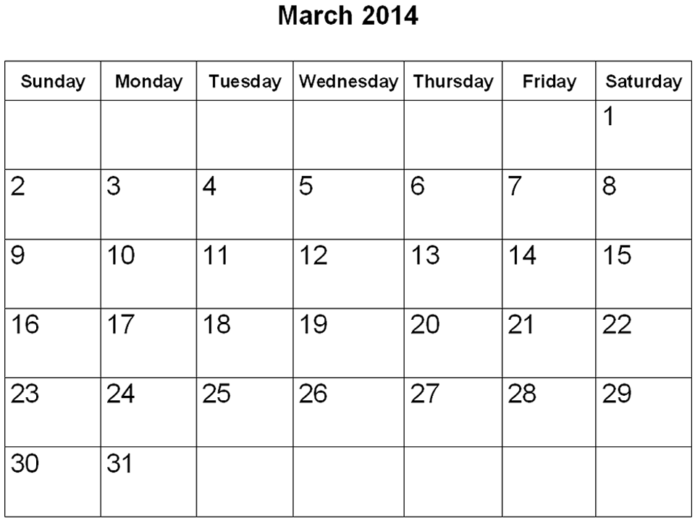
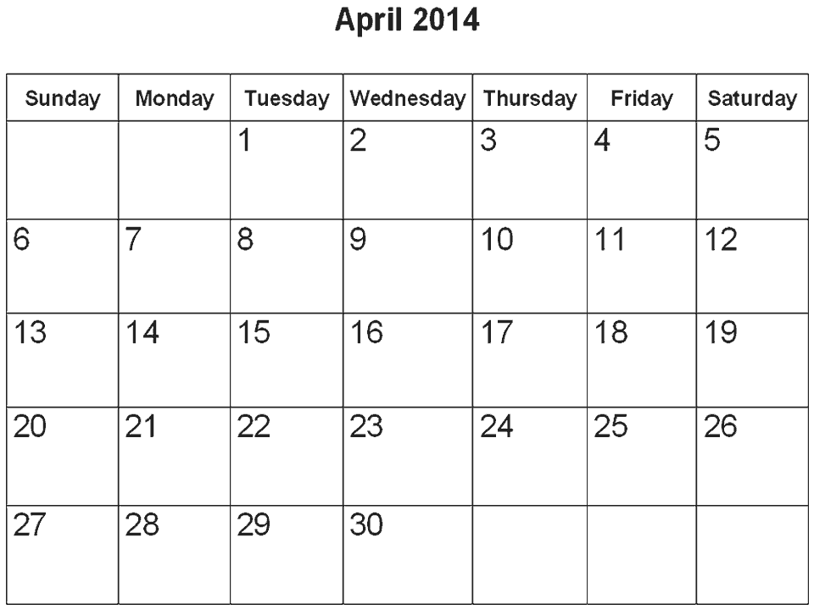
What is WorldCat Discovery Services?
A single reference and discovery solution to replace FirstSearch and WorldCat Local
Available to any library with a FirstSearch subscription in March 2014
WorldCat Local/WMS transition began with a beta in April 2014
Notes:
Over the next 18 months or so, WorldCat Discovery Services will replace the FirstSearch and WorldCat Local services. It will be available to all libraries that currently subscribe to FirstSearch, either on their own or through a group subscription.
WorldCat Local libraries and WMS libraries that use WorldCat Local for discovery will also move to WorldCat Discovery Services over the next 18 months. Their transition will begin in April with a beta period during which librarians can begin using the new services and plan transition activities.
WorldCat Discovery Services is a discovery application, with services like a link resolver and A-Z list delivered through it. Similar to OCLC’s WorldShare Management Services suite, WorldCat Discovery Services is cloud-based and takes advantage of the latest advances in technology infrastructure, to provide you with a library discovery experience that supports both staff and end-users.
There are also additional options you can add to the suite, to tailor it for your local library. You may add one or more of these options to your WorldCat Discovery subscription.

Slide 17
WorldCat Discovery Services
Libraries with current holdings in WorldCat + WorldCat knowledge base receive:
Local library collections listed first in search results
Link resolution to full-text resources in e-content subscriptions
Built-in A to Z list
Option to add:
Real-time availability (if you have an interoperable ILS)
Group views
Course reserves
Remote database searching
Custom reporting via Adobe® Reports & Analytics
Current FirstSearch subscribers receive:
Single search of all content available through FirstSearch today (including Base Package databases), plus
200+ million article-level records
Central index that represents more than a billion articles, e-books and other e-content*
New user interface that adapts automatically to mobile devices
Library-branded URL and custom branding
Option to purchase remote database searching
* Access to full text depends on library subscriptions
Notes:
If you currently subscribe to the WorldCat database on FirstSearch, you will continue to access WorldCat through WorldCat Discovery. The new service will also provide single-search access to even more content, including:
Databases previously purchased through the FirstSearch Base Package
More than 200+ million article-level records from sources that include JSTOR, Elsevier and British Library Inside Serials
A central index that represents more than a billion items from nearly 2,000 content collections. This is the central index that has previously been available only through the WorldCat Local service. Searching of this greatly expanded set of metadata means your users are more likely to identify resources they need.
This completely new interface adapts automatically to a user’s device, so users can conveniently use the service from the device they prefer.
Your library will receive a unique URL for your WorldCat Discovery site. You may brand this interface to match your existing library branding.
In addition, you can purchase the option to search remote databases that are not indexed in the service’s central index.
Libraries that maintain current holdings in WorldCat benefit even more from WorldCat Discovery. The presence of holdings in WorldCat means that local resources will be listed first in search results. When local data is also added to the WorldCat knowledge base, the service has the information it needs to connect your users from full-text citations to full text in e-resources to which your library subscribes. This holdings information also supports a built-in A to Z list of your e-resource subscriptions.
Libraries with up-to-date holdings in WorldCat can also purchase options that add value to those holdings. These include:
Real-time availability - enabled by linking from search results to a library’s ILS
Group views – that surface holdings of other libraries in your group or consortium
Course reserves/reading lists – that enable short-term access related to a specific course or topic
Custom traffic and usage reporting via Adobe Reports & Analytics (previously known as Adobe SiteCatalyst). This is a more customized option than access to Google Analytics, which is included in WorldCat Discovery Services.

Slide 18
Visibility for library collections maintained in WorldCat and direct links to most popular content
WorldCat partner traffic
July 2012-June 2013
77 million referrals from partner sites
8.7 million click-throughs to libraries
Examples of the content providers represented in the central index
Notes:
Libraries that maintain holdings in WorldCat also gain Web visibility for their collections on the websites of OCLC partners. The sites on which library collections appear are some of the more popular consumer and research sites where people usually begin their research. These include sites such as GoogleBooks, BibMe, EasyBib, Goodreads, Wikipedia, Mendeley.
A new partner is FamilySearch, a premier genealogical research tool. We have recently added more than a million records from FamilySearch to WorldCat, so they are easily discoverable by people who search WorldCat – or soon WorldCat Discovery Services – for genealogical information.
During the period from July 2012 to June 2013, more than 8.7 people who reached WorldCat from a partner website went on to click through to a library website to obtain the resources they needed.
This Web visibility for OCLC cataloging members is enabled now through a subscription to FirstSearch – and soon through a subscription to the new WorldCat Discovery Services.
When you add local data to the WorldCat knowledge base, you also enable direct links to full text in nearly 2,000 e-content collections with a mutual subscription to the content, and also display an A to Z list of electronic resources. It is the WorldCat knowledge base that maintains detailed information about the content to which your library subscribes.
We work with leading content providers and aggregators and have the largest database of e-books available—more than 15 million—for the benefit of libraries and library users.
As you can see from the selection of content partners displayed on this screen, OCLC’s service enables people to discover the resources they need from collections libraries subscribe to most. This screen provides just a few examples of the content providers represented in the central index searched through WorldCat Discovery Services. NOTE: If anyone asks whether EBSCO collections are included in the WorldCat Discovery central index, you can say that EBSCO and OCLC are in ongoing discussions about the most appropriate ways to surface their content in our services.

