Slide 1
Student Life Student Wellness Center Overview
Arianna Camel, MSW, MSEM, Associate Director

Slide 2
Mild Moderate Severe concerns
2

Slide 3
IF STUDENTS ARE EXPERIENCING…
Mild, Common, and Developmental Concerns
• Homesickness
• Not participating or regular disagreements
• Mild changes in mood
• Feelings of being overwhelmed
Procrastination
Test Anxiety
Adjustment to a new environment
Problems making friends
Friction with an instructor
Being excluded

Slide 4
IF STUDENTS ARE EXPERIENCING…
MODERATE
• Excessive absences
• Significant increase or decrease in sleep/appetite
• Increase in use of drugs and/or alcohol
• Panic attacks
• Not taking care of self/neglecting personal hygiene
Withdrawing from friends and family
Frequent crying spells
Anxiety or mood changes significantly interfering with life
Ongoing interpersonal problems

Slide 5
Severe and Urgent Concerns
Behaviors
• Violence
• Unpredictable angry outbursts
• Inability to communicate clearly
• Suicidal or homicidal thoughts
• Loss of contact with reality
Extensive and dangerous substance use
Unable to take care of basic needs
Events
Hazing
Unwanted Sexual Experience
Assault
Hate Crime
Recent Grief and Loss
Legal or Conduct Consequences

Slide 6
Student Wellness Center Overview
Health and Wellness on Campus
Counseling and Consultation Services
Mental Health Practitioners: Psychologist, Psychiatrist, Certified Counselors
Confidential Resource
Individual, Group, and Couple Counseling, Workshops, Crisis Debriefing, Community Referrals, etc.
Wilce Student Health Center
Medical Doctors
Confidential Resource
Outpatient Facility providing: Primary Care, Vaccine Requirements, Gynecological Services, Physical Therapy, Dental Care, Pharmacy, Nutrition Therapy, Referrals, etc.
RecSports
Group Fitness
Personal Training
Sports Clubs/ Intramural Sports
Outdoor Recreation
Aquatics/Gyms
Student Wellness Center
Private Services
Holistic Wellness
6
Notes:
Explain the differences between the three offices and how we collaborate with one another.

Slide 7
HOLISTIC WELL-BEING
7

Slide 8
Student Wellness Center Overview
“Wellness is an active and ongoing process that allows individuals and the broader community to reach their full potential.”
The Ohio State University
Student Life Student Wellness Center
8
Notes:
Read definition
Wellness is something that we are all going to have to actively work on for the rest of our lives, it is an ongoing process and as we move through life our needs change. Taking steps now to recognize our wellness needs will set us up for success in the future in recognizing needs and addressing them as they arise.
Individual well-being involves being happy and satisfied with life, having basic needs met, and contributing to the communities in which we live.
Community well-being involves creating and sustaining an environment that is equitable and just for all.

Slide 9
Student Wellness Center Overview
10 Dimensions of Wellness
Wellness is interconnected
This means that focusing on any dimension can benefit your whole life.
Career
Creative
Digital
Emotional
Environmental
Financial
Intellectual
Physical
Social
Spiritual
9
Notes:
Explain each dimension.
On the screen you can see the nine dimensions of wellness promoted by The Ohio State University. There are a number of different resources across campus that help to promote these dimensions including but not limited to the Student Wellness Center, Counseling and Consultation Services, RecSports, the Younkin Success Center, and the list goes on!
Each dimension is multifaceted and encompasses more than you would think.
It is important to note that all dimensions of wellness are interconnected. This means that they all have an impact on each other. If you ignore one dimension it will bring others down, if you promote another it will help bring others up. An example of this is your emotional wellness. Ignoring your emotional wellness can have impacts on a number of different dimensions including your social wellness, if you are feeling down and depressed you might push away friends and family members who are trying to help; your physical wellness could be impacted as well if you engage in coping mechanisms that might not always be the healthiest options like partaking in risky alcohol and other drug behaviors.
It is important to be conscious of each of the dimensions and make sure you are taking time to care for each. Take advantage of the resources and services available on our campus to help set yourself up for success.

Slide 10
ALL OF OUR SERVICES ARE FREE AND PRIVATE
10
Notes:
All of the services offered through the Student Wellness Center are completely free at no cost to the student - no insurance necessary to access a resource in our office.
All of our services are private. This means that all conversations and interactions with our office are kept private except if a Title IX or Cleary Act violation is disclosed to one of our volunteers or staff members – all of whom are mandated reporters. In that situation we do have to report to the correct governing body.

Slide 11
Student Wellness Center Overview
Locations
Main Suite
RPAC B130
Wellness Coaching
PAES
Collegiate Recovery Community
095 Baker Hall
Buckeye Food Alliance
Lincoln Tower, Room 150
St. Stephens Episcopal Church
Visit our website to learn more about our ours of operation, which vary by location.
11

Slide 12
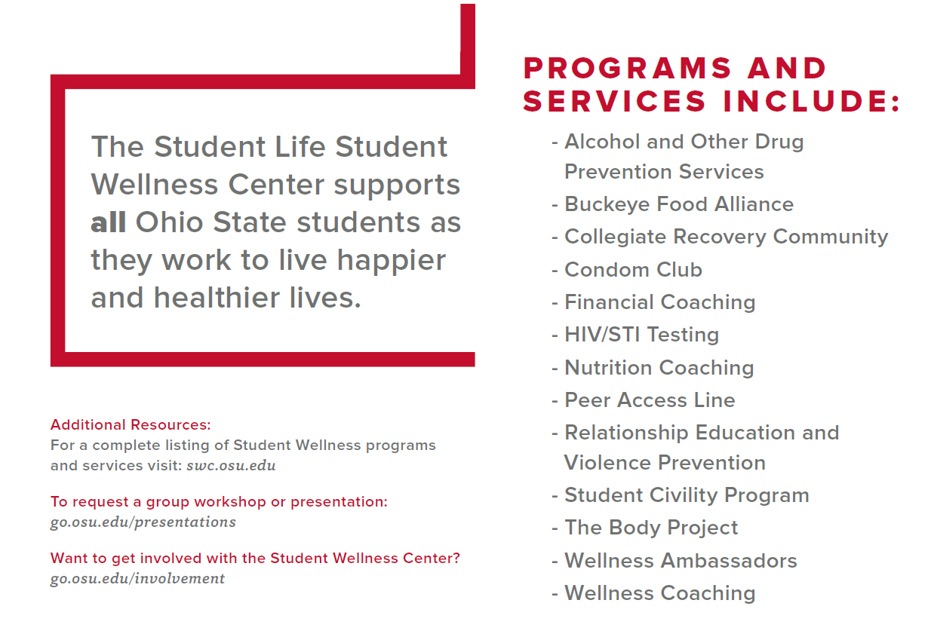
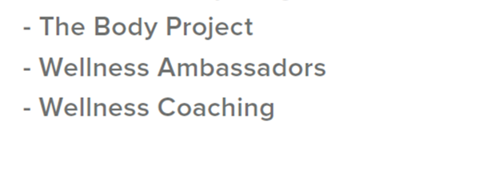
Student Wellness Center Overview
12
Notes:
We are going to go over a few of these in greater detail here in the next few slides, but if you have questions about any specific service please feel free to ask!
Explain outreach, volunteer opportunities, and presentation requests on this slide before moving on.

Slide 13
Student Wellness Center Overview
On-Demand Resources
Wellness Assessment
Wellness App
ScreenU
iGrad
SilverCloud
Community Provider Database
13
Notes:
iGrad is a financial literacy platform offered to Ohio State students free of charge. This interactive website allows students to complete personal finance education courses and interactive activities around the following topics: Student Loans, Smart Borrowing, Planning for Retirement, Investing, Identity Theft, Budgeting, Banking and Credit Cards. Complete a course now to get a jumpstart on your financial wellness!
ScreenU is a brief, anonymous assessment for students to identify their potential risk for harmful consequences of misusing alcohol, marijuana or prescription drugs. Complete one or all of the assessments today to learn about helpful resources you can use now and when classes start!
SilverCloud is an online, interactive mental health resource that provides students with cognitive behavioral skills and strategies accessible 24/7. SilverCloud can be either self-guided or used with the support of a coach. SilverCloud does not require a referral and you can start right now. Not designed to replace in-person mental health treatment, especially for more complex concerns.
Anxiety
Depression
Stress
Insomnia and Sleep issues
Resilience
Emotional support with COVID-19

Slide 14
INVOLVEMENT OPPORTUNITIES
14

Slide 15
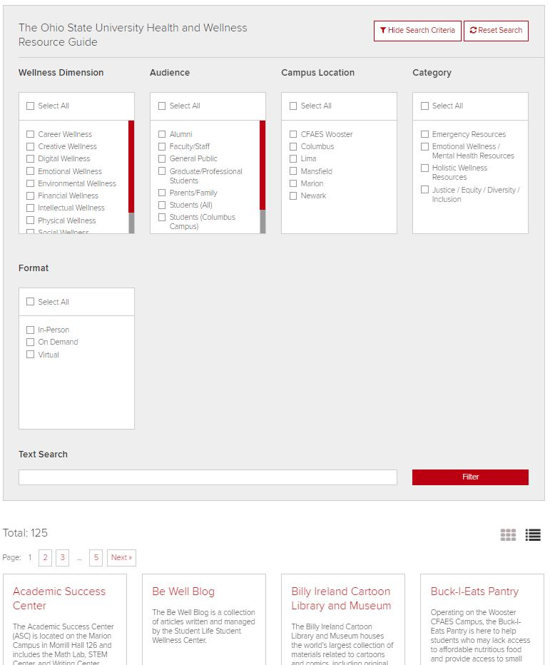
Health and Wellness Resource Guide
go.osu.edu/wellnessguide
15

Slide 16
Student Wellness Center Overview
Involvement and Support
Volunteer in our Office!
Signature Events
Love Your Body Week (Feb. 21-25, 2022)
Sexual Assault Awareness Month (April)
Recovery Month (September)
go.osu.edu/swcevents
16
Notes:
Explain each of the resources

Slide 17
Student Wellness Center Overview
Questions? Thank You!
Student Wellness Center
RPAC Room B130
OSUwellness OSUwellness
swc.osu.edu
wellness@osu.edu
Associate Director – Arianna Camel.2
Faculty and Staff Engagement Coordinator - Jordan Helcbergier.1
17
Notes:
All on the same page about what privilege means

