Slide 1
Using MyLab or Mastering: A guide for students at The Ohio State University

Slide 2
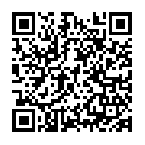
Using MyLab or Mastering on an iPad
Are you planning to use your iPad to access MyLab or Mastering? Here are some instructions to get you started:
Make sure you're not using the Carmen app. Students must use Safari on the iPad.
Go to settings app and select Safari:
Still need help? Here is a video from real Ohio State students to take you through the process.
- Turn off "Block Pop-ups"
- Turn off "Block All Cookies"
- Turn off "Prevent Cross-Site Tracking"

Slide 3
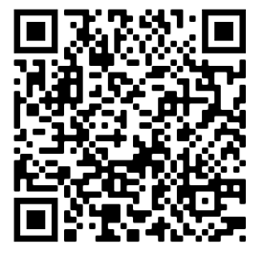
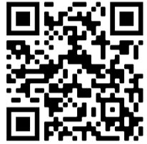
MyLab/Mastering Registration
For Columbus Physics Mastering courses: (Not integrated with Canvas)
MyLab & Mastering registration in Canvas

Slide 4
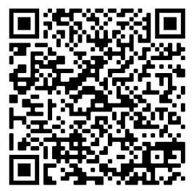
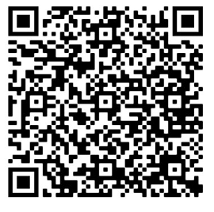
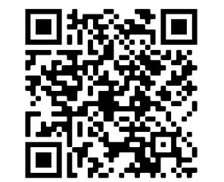
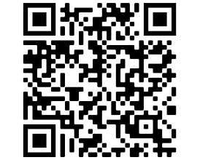
Common Problems and Solutions
Check your browser
Examples: Safari, Chrome, and Firefox
Clear cache & cookies
"Time-out" errors or "session error" messages
Allow pop-ups & cookies
Errors such as eTexts/assignments not opening
I need help upgrading from
temporary access for MyLab/Mastering
It says I have a Pearson account with my email address, but when I click “Forgot Password”, I never get an email.
Create a new account.
You can use your same email address, but you'll need a unique username. Simply click “close” when you are prompted that you may have an account and you'll be able to continue creating your new account.

Slide 5
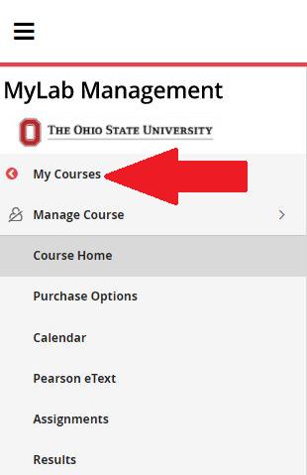
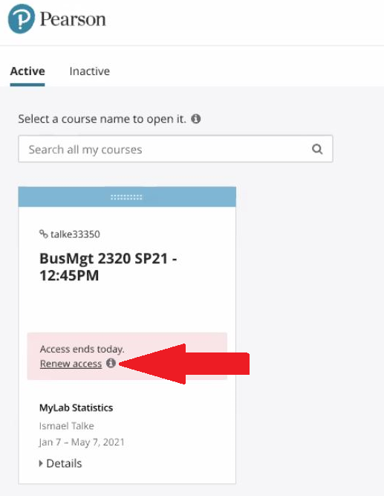
Access Renewal Instructions for CHEM 1220, BUSMGT 2320, SPANISH, and PORTGSE Courses
1. From within your MyLab or Mastering Course, select the link for My Courses from the left-hand navigation pane.
2. On the course tile, select the link to “Renew Access”
3. Copy and paste the access code that was provided by your instructor at the beginning of the term for Pearson registration.

Slide 6
If you’ve gone through the above and still need more help or have a unique situation see the following slides.

Slide 7
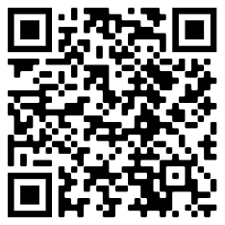
Tech support: 24/7 Assistance!
To contact Pearson Support any time of day or night, please scan this code
OR
text 'Hi' to 1-866-264-0618 for assistance.

Slide 8
Still have questions? The local Pearson rep and OSU Student Pearson Employees can help…

Slide 9
Pearson OSU Virtual Office Hours Information
DATES TIME k
Mon 1/11/21: 12:00pm-2:00pm Tues 1/12/21: 10:00am-12:00pm Wed 1/13/21: 12:00pm-2:00pm Thurs 1/14/21: 9:00am-11:00am Fri 1/15/21: 12:00pm-2:00pm Tues 1/19/21: 9:00am-11:00am & 1:00pm-2:00pm
LOCATION
http://zoom.us/j/5255123067

