Slide 1
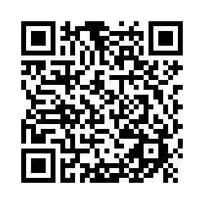
The General Chemistry Experience Survey-Part 2
Dear Students: The chemistry department wants to learn from you!
We would appreciate your for completing the survey-Part 2.
Time: The survey will take 15-20 minutes to complete.
Incentive: Upon completion of the survey, your name will be entered in a random drawing for a chance to win a $20 cash award. There will be five winners selected at random for each course. The odds of winning will depend on the number of students who complete the survey.
Survey Link: https://osu.az1.qualtrics.com/jfe/form/SV_6VgdR0VWN4X36nQ
(Also available on Carmen Announcement)
(Aim your camera on phone or iPad at this code for access to the survey)

