Slide 1
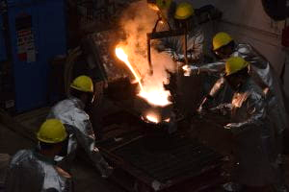
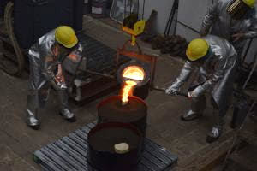
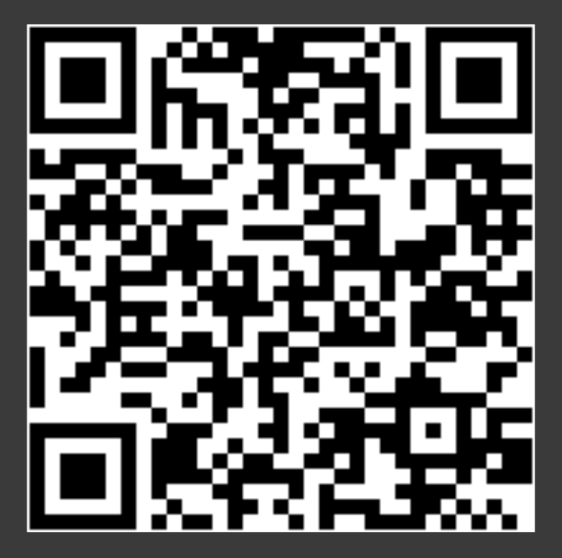
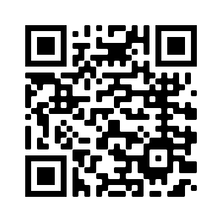
The American Foundry Society
Join our GroupMe
Please fill out this schedule poll
The Ohio State University Chapter
http://u.osu.edu/afsatosu
Sign up for the email list at:
https://lists.osu.edu/mailman/listinfo/afsosu
Notes:
https://urldefense.com/v3/__https://groupme.com/join_group/57782545/miZZFSvD__;!!KGKeukY!nnF_bBT1CNQnlQkZjCl1iUaR5PDAHABeM6-cjUzLEpsQPPTCKcTkhMCrh3gFoTdNdLs$

Slide 2
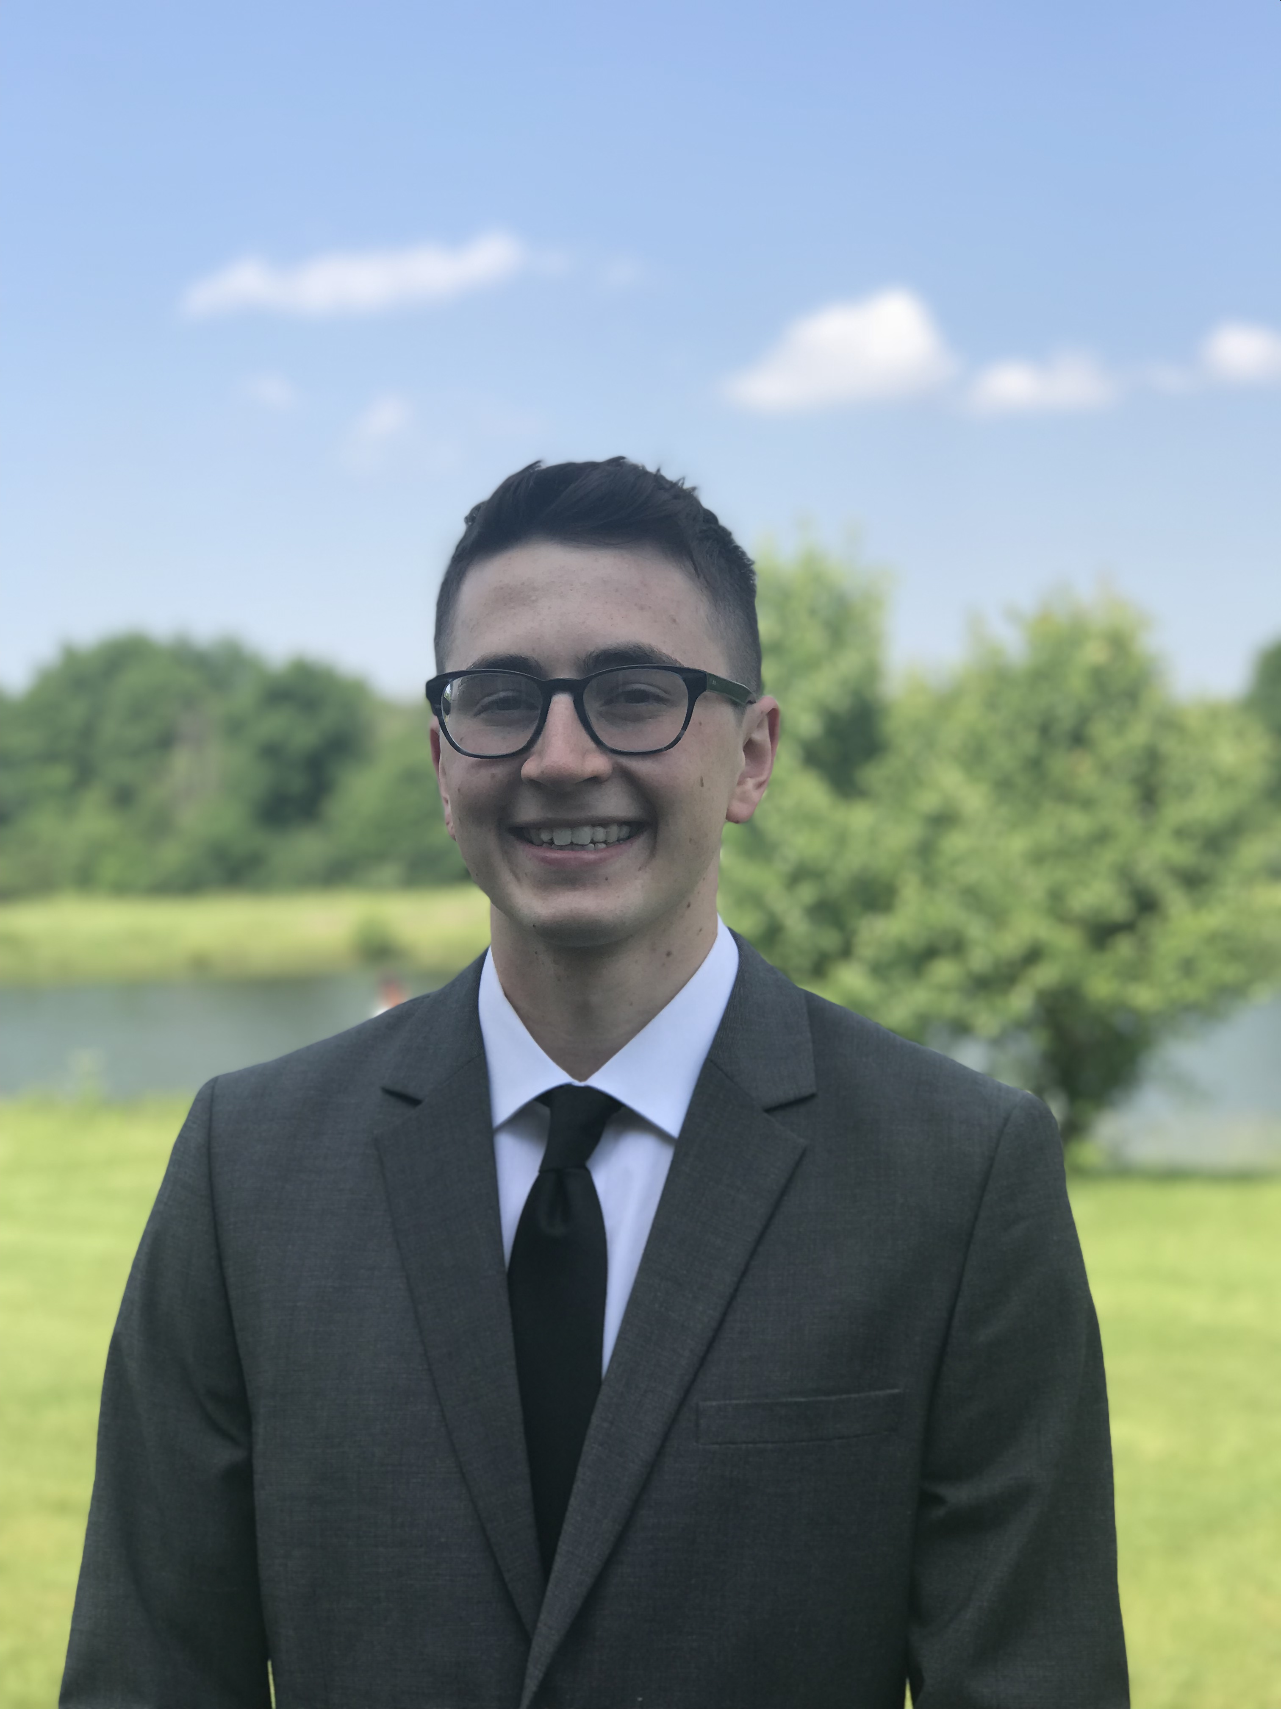
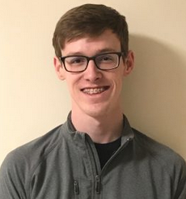
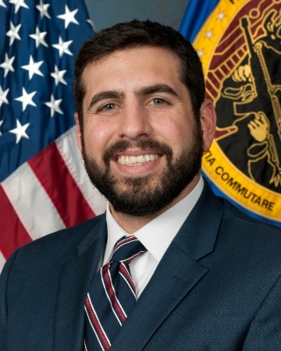
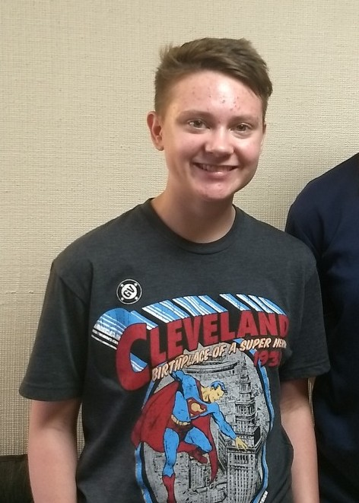
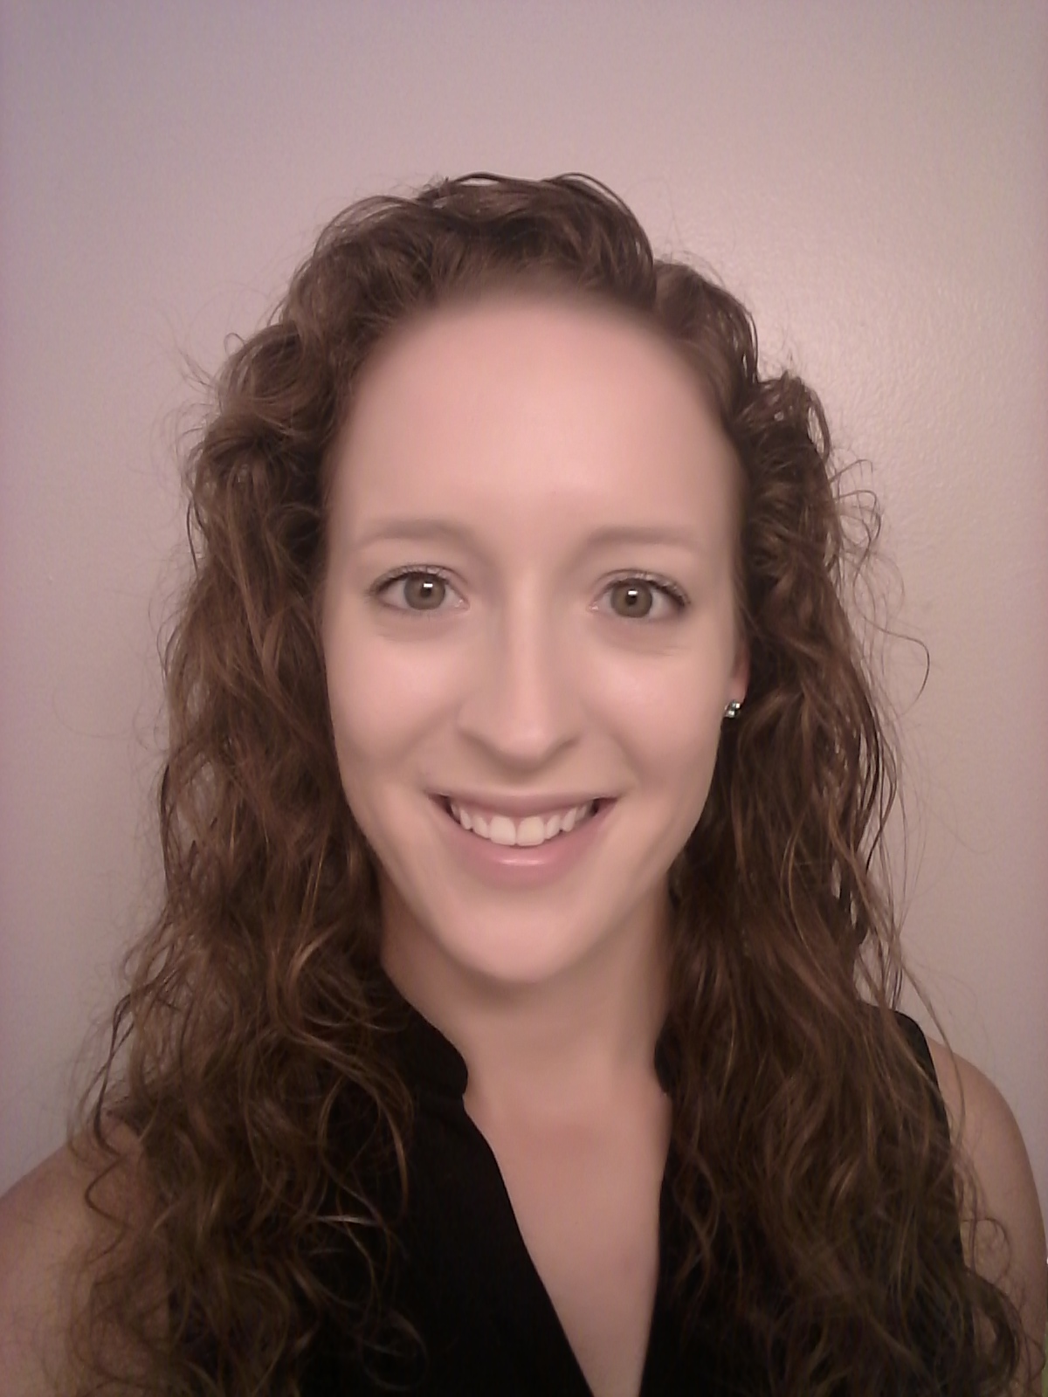
2020 Officers - Advisor: Dr. Alan Luo, MSE
Michael Moodispaw (.4)
President
Troy Lewis (.2250)
Vice President
Blake Barnett (.615)
Treasurer
Liam Clink
(.6)
Ecouncil Rep
Rebecca Vilcheck (.1)
Secretary
Hayden Beatty (.231)
Social and Outreach

Slide 3
What is foundry club about?
(what is a foundry)

Slide 4
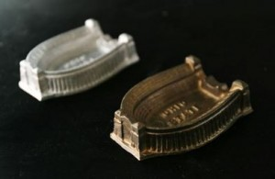
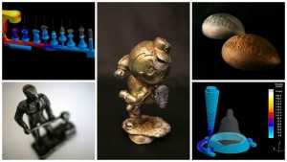
What We Do
Foundries are molten metal processing facilities
Shape castings, billets, tube, etc.
OSU AFS chapter
Partners with AFS Central Ohio Chapter (industry partners)
Use MSE on-campus foundry to make small castings (Al)
Professional talks
Foundry tours
CIC
Networking, FEF job search system

Slide 5
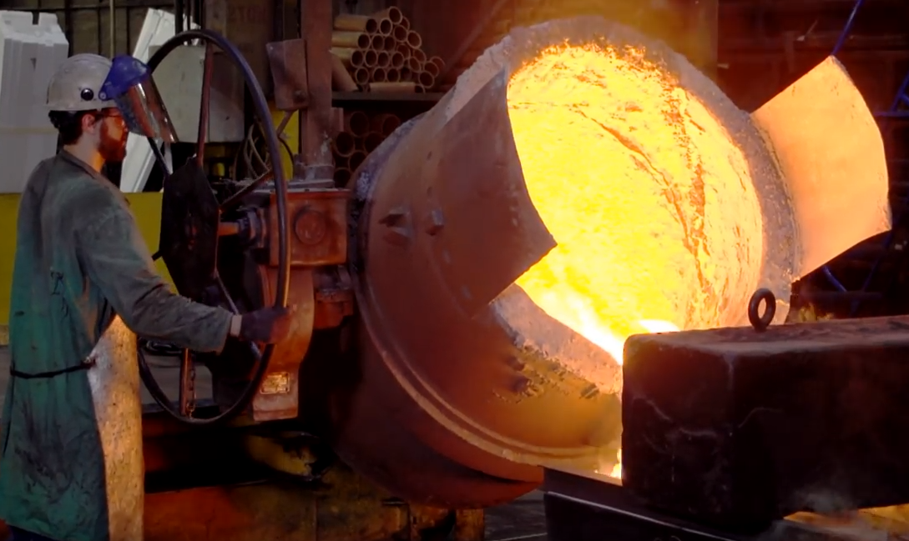
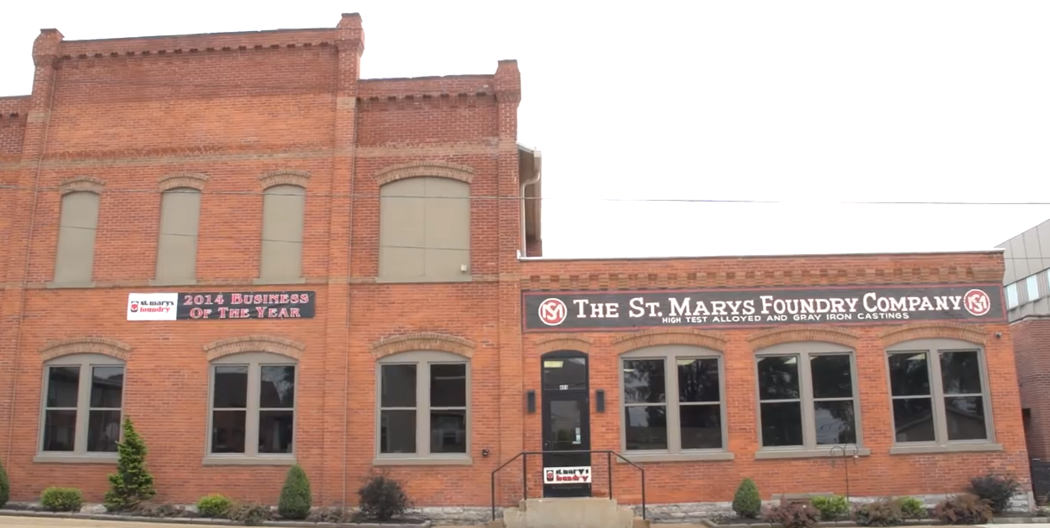
Professional Development/ Plant Tours SP20
St. Marys Foundry
Specialty iron and steel foundry
Tour in Early February
Industry Talk – Lyle Heberling
Executive Director of Iron Casting Research Institute, Inc.
Late February

Slide 6
What is foundry doing this semester?

Slide 7
Professional Development/ Educational Talks
Ideas:
Presentation on Al casting – Michael
Presentation on the casting industry (or Mg casting?) – Dr. Luo
Entering the industry (what are employers looking for?)
Foundry safety
Industry case analysis about some improvement to casting operation
Some remote demonstrations or video of foundry/casting operations
FEF talks
Other ideas?

Slide 8
Thank you
Join our GroupMe
Please fill out this schedule poll
The Ohio State University AFS Chapter:
http://u.osu.edu/afsatosu
Sign up for the email list at:
https://lists.osu.edu/mailman/listinfo/afsosu
FEF:
https://www.fefinc.org/
Notes:
https://urldefense.com/v3/__https://groupme.com/join_group/57782545/miZZFSvD__;!!KGKeukY!nnF_bBT1CNQnlQkZjCl1iUaR5PDAHABeM6-cjUzLEpsQPPTCKcTkhMCrh3gFoTdNdLs$

