Slide 1
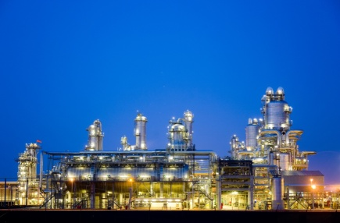
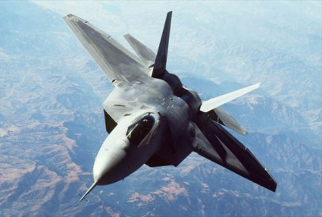
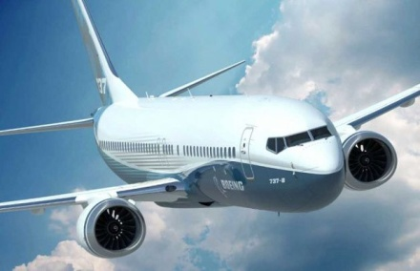
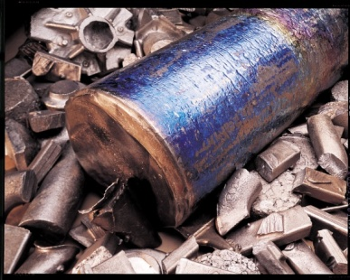
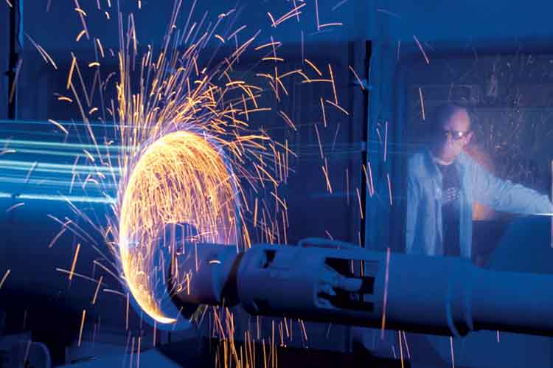
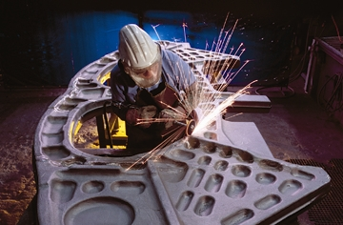
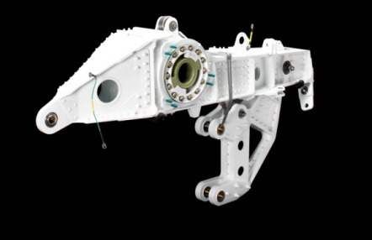
Precision Castparts Corp. (PCC) is a Berkshire Hathaway company that manufactures world-class complex metal components and products; serving the aerospace, power, and general industrial markets. PCC has more than 160 facilities worldwide, with over 100 located in the US. Numerous career paths are available within PCC as a result of our extraordinary growth and market leverage.
PCC Airfoils, LLC is a wholly-owned subsidiary of Precision Castparts Corp. The Airfoils Division manufactures complex highly technical investment castings for turbine engine applications used in commercial jet engines, military jet engines, helicopters and industrial gas turbines.
We are seeking highly motivated IMPACT players to join our world of MANUFACTURING
Do you thrive in a fast-paced, challenging environment where you are rewarded for results? Do you want to be a member of a team that is driven to win? If so, Precision Castparts Corp. may be just the place for you to build your career.
Come visit us on campus:
Thursday, April 11, 2019
Information Session – 5:30 p.m. – MacQuigg Lab, Room 162
Food and Beverages Provided!
We’re Hiring!
Development Program (TDP)
Direct Hire – Technical
Direct Hire - Operations
Co-op
Engineering
Materials Science/Metallurgy
Mechanical
Industrial Systems
www.precast.com/careers
All divisions of Precision Castparts Corp. are equal opportunity employers committed to recruit, hire, upgrade, train and promote in all job categories without regard to race, color, religion, sex, sexual orientation, gender identity, national origin, age, disability, veteran status or other status protected by applicable law.

