Slide 1
The American Foundry Society
The Ohio State University Chapter

Slide 2
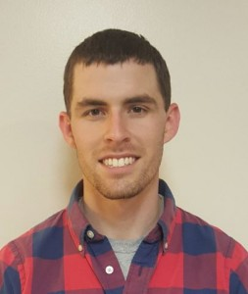
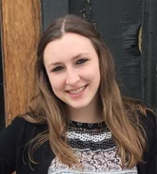
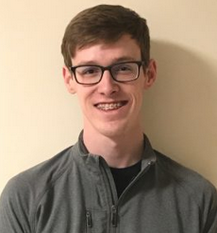
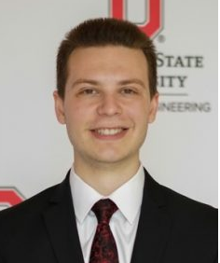
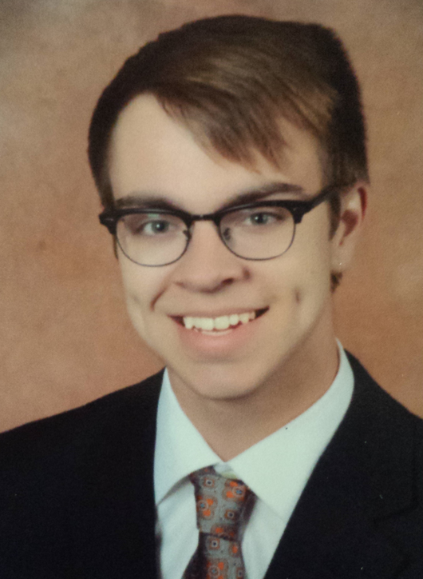
2018 - 2019 Officers
Colin Ridgeway (.38)
President
Sarah Ridgeway (.59)
Vice Chair
Troy Lewis (.2250)
Treasurer
Adam Braff (.6)
E-Council Rep
Jack Canaday (.20)
Secretary

Slide 3
Activities

Slide 4
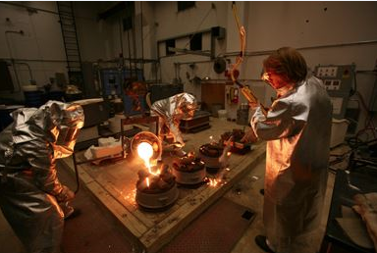
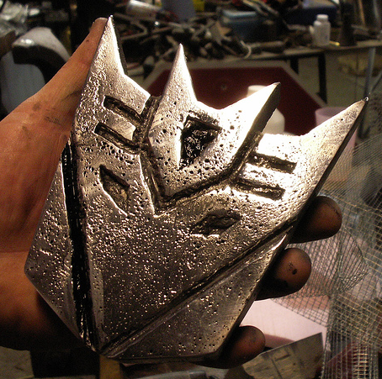
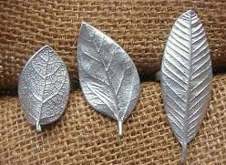
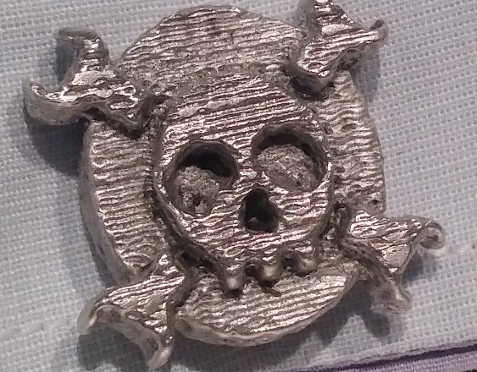
Foundry Meetings
50+ Pre made patterns to choose from
We want YOUR ideas!
We can make your imagination happen!

Slide 5
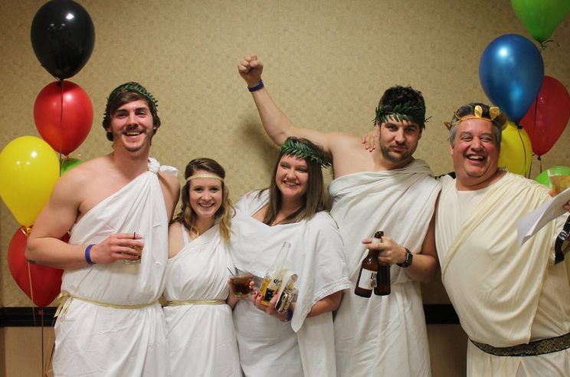
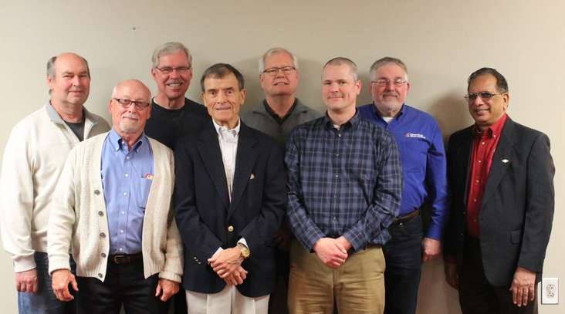
Networking --- Central Ohio AFS
-1 Meeting each month (Every 3rd Thursday)
-Chance to meet & network with professionals in the industry
-Build relationships and create opportunities for internships/Co-Ops

Slide 6
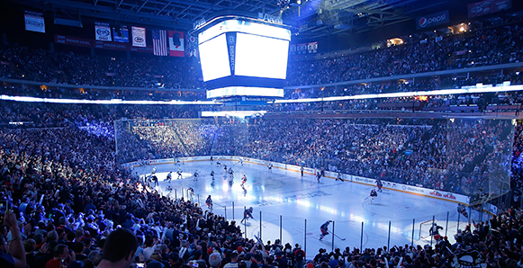
Fundraising
- 3 – 4 games a year
- Invite AFS and other family members for networking in laid back environment
-We would like to invite YOU and your friends too!
asdf

Slide 7
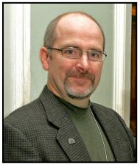
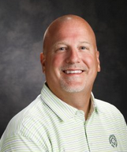
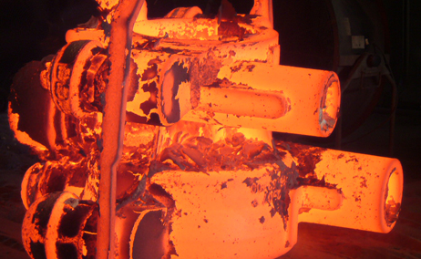
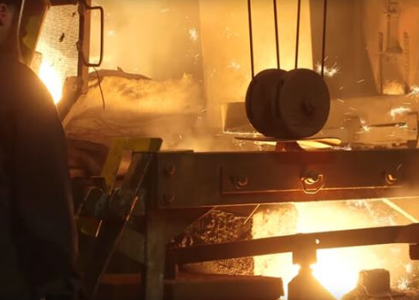
Professional Development/ Plant Tours
Local professionals join us and share different casting techniques
Great way to network!
Plant Tours
Offers a chance to see a foundry
in action!

Slide 8
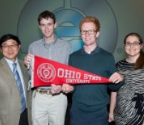
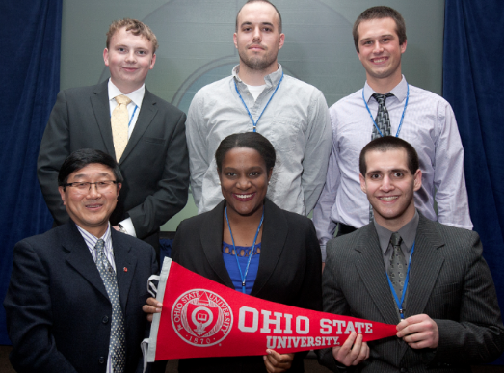
CIC Conference in Chicago
Annual Meeting in Chicago
Foundry Specfic Career Fair
1-on-1 meetings with potential employers
All-expenses paid trip to Chicago
Wined and dined by industry
Scholarship Opportunities!

Slide 9
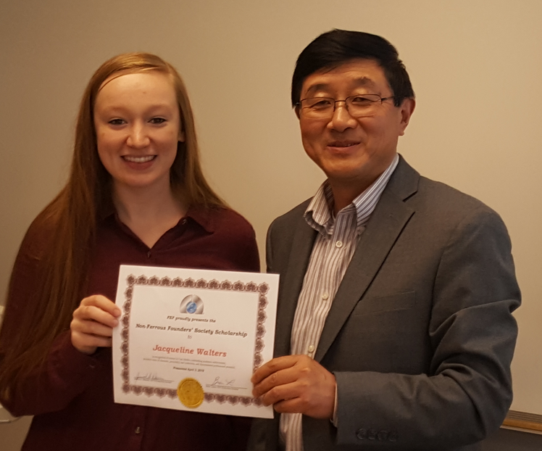
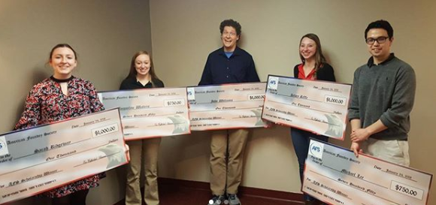
Scholarships
Last year (2017-2018) received $16,250 in scholarships
→ Annual Scholarship through FEF (~$4,000)
→ Central Ohio AFS (~$3,000)
→ General FEF Scholarships
→ Metal Casting Congress Awards
http://u.osu.edu/afsatosu/scholarships/2018-winners/

Slide 10
Previous Projects

Slide 11
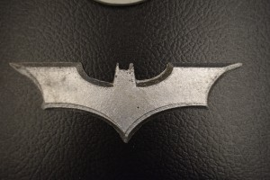
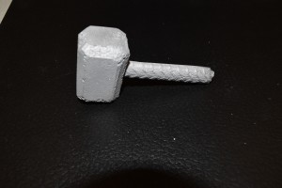
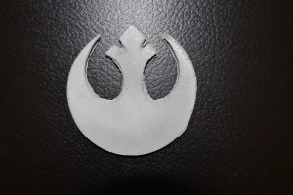
Comic Con Table Decorations

Slide 12
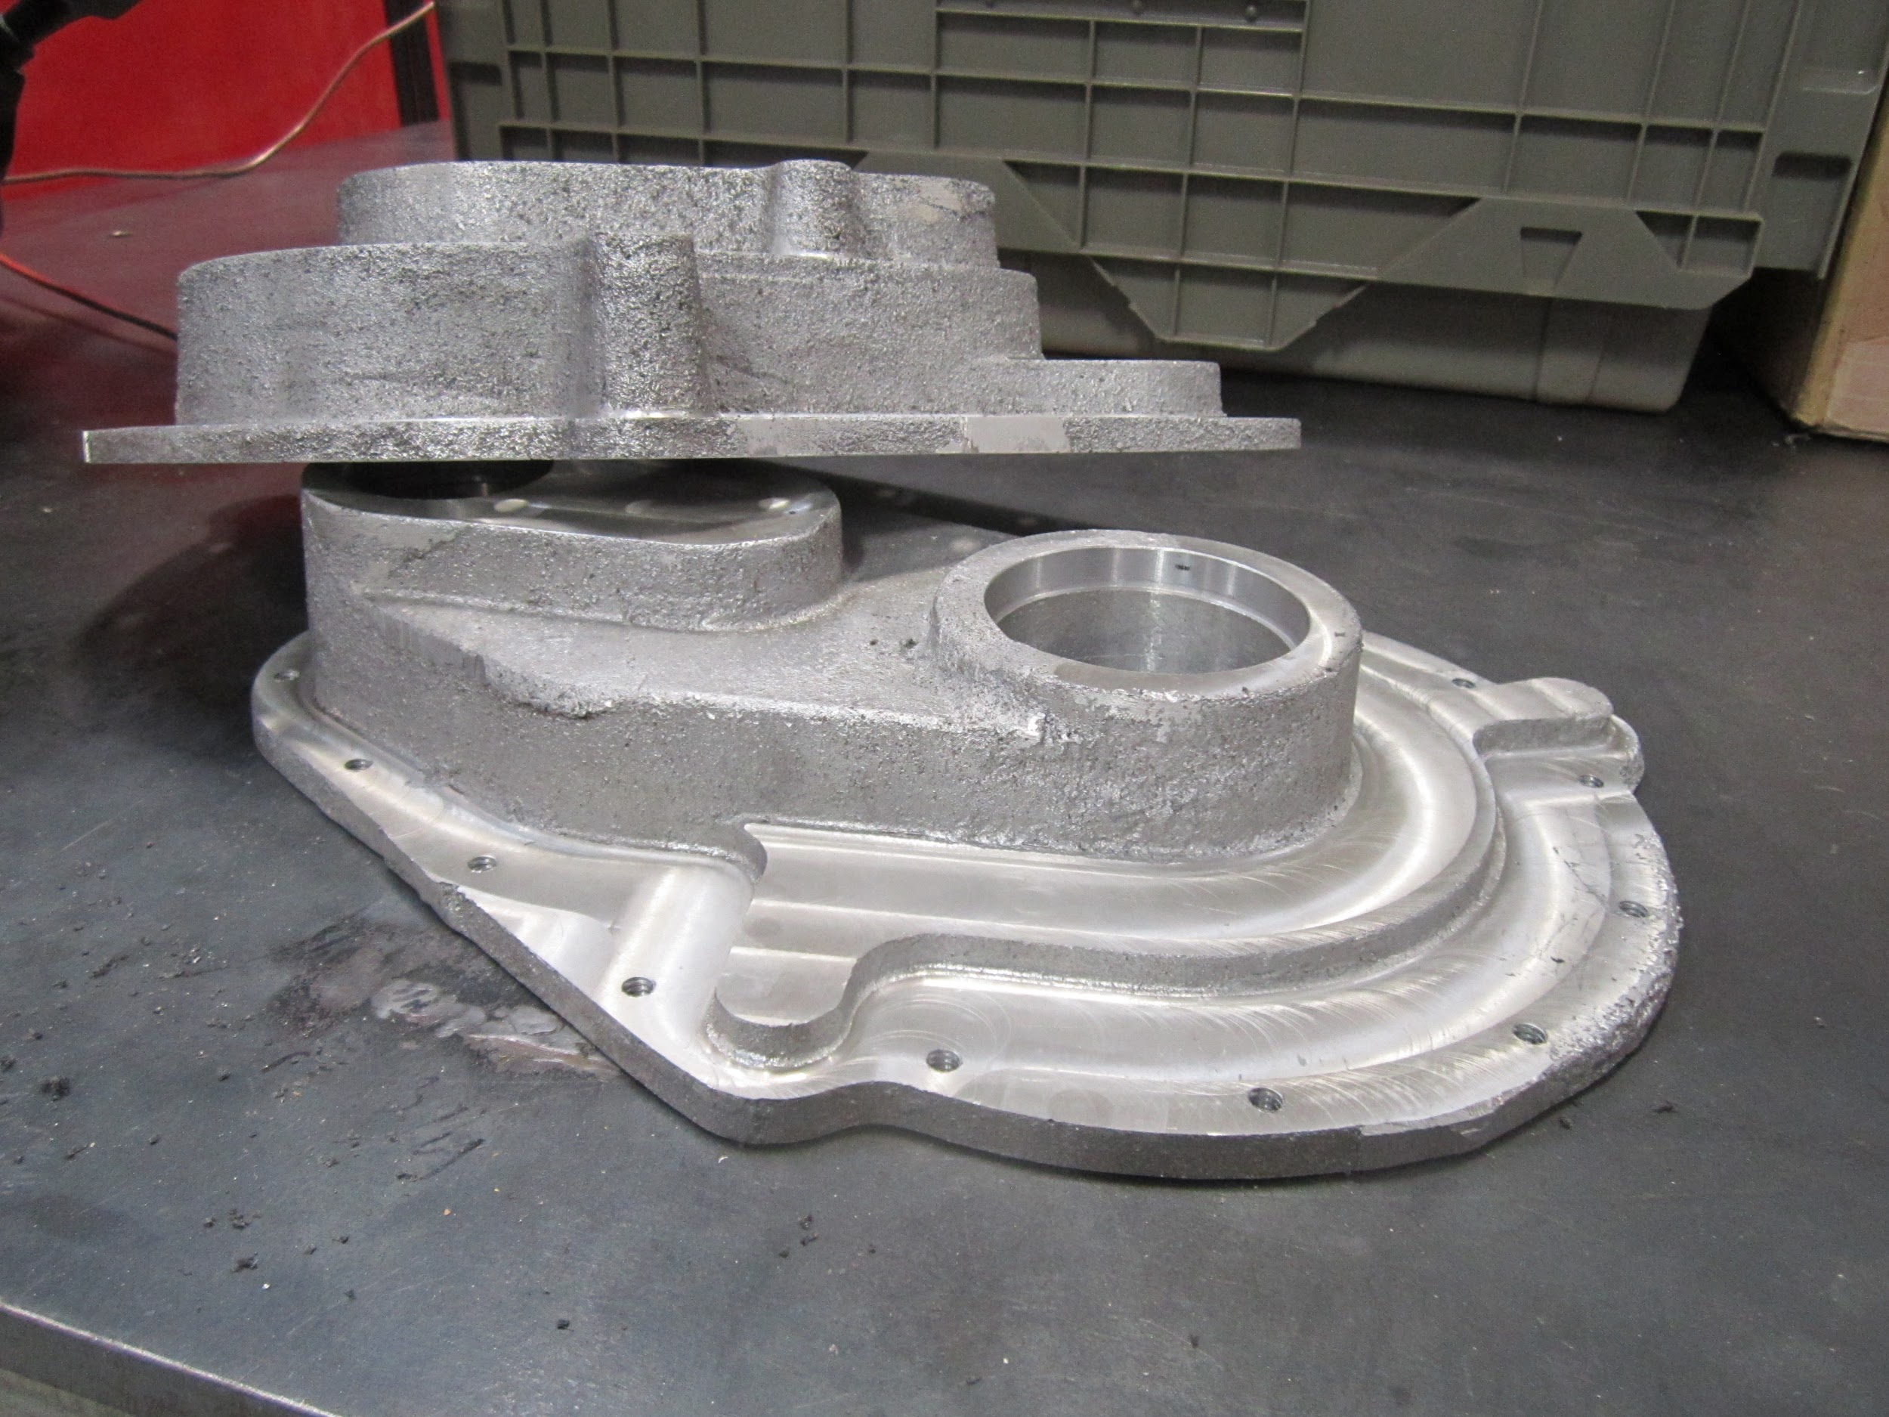
BAJA Buckeyes Gearbox

Slide 13
Future Projects
Buckeye Space Launch Initiative:
→ Partnership to make seniors rings
Central Ohio AFS Speaker Award:
→ Need to cast 10+ for Central Ohio AFS Chapter
Your Ideas:
→ Any project you might have we can do it!

Slide 14
Next Steps
Fill out the Doodle form for availability this upcoming semester
Attend Central Ohio AFS meeting on Thursday, Sept 20th at the Makoy Center
Watch for e-mails from officers about upcoming events
Your Ideas:
→ Any project you might have we can do it!

Slide 15
Follow us on:
Twitter afs_osu
Instagram afs.osu
Facebook Afs Osu
Bs to visit the website for updates! http://u.osu.edu/afsatosu

