Slide 1
The American Foundry Society
The Ohio State University Chapter

Slide 2
Meet Your Officers

Slide 3
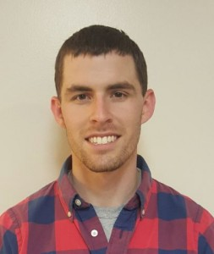
Colin Ridgeway.38 - Chair
Undergraduate: BS, Materials Science and Engineering, The Ohio State University (2015) Graduate Studies: GRA in Light Metals and Manufacturing Research Group Research: Ablation Casting for Automotive Applications Previous Positions:
AFS Secretary (2014-2015)
AFS Chair (2015-2016)
Board Member Central Ohio AFS (2015 -)
Hobbies: Hunting, golf, guitar
Past Internships/Research: 2012: Bodycote 2013: Bodycote Kolsterising, Researcher, Engineering Intern, (Konstanz, Germany) 2014: TimkenSteel, Metallurgical Engineering Inter (Canton, Ohio)

Slide 4
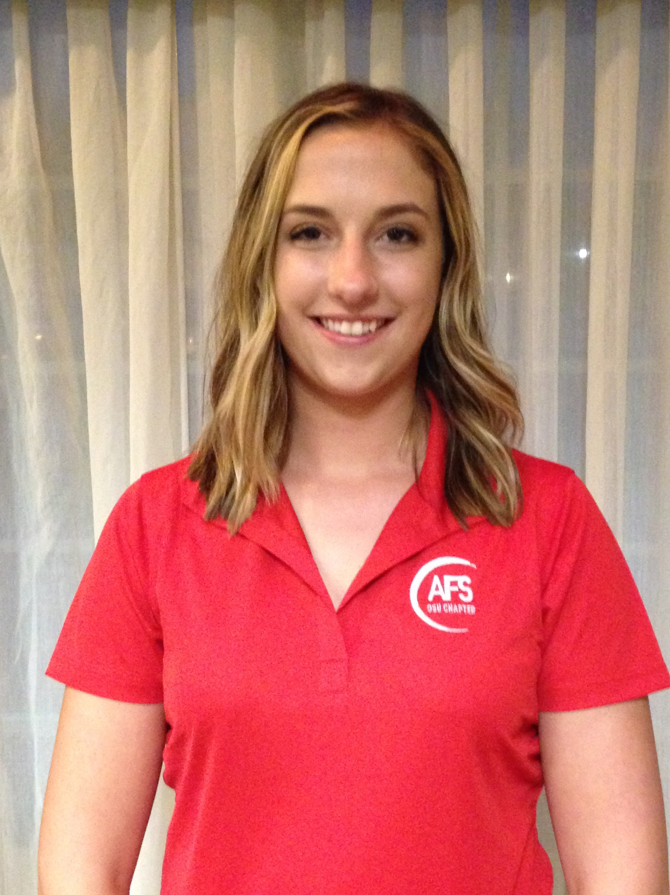
Tori Hicks.462 - Vice Chair
Major: 4th year, Materials Science and Engineering Graduation Date: May 2018
Hobbies: Figure skating, running, traveling
Internships/Research: Spring/Summer 2015: Precision Castparts Corp. Airfoils, Product Engineering Co-op, (Minerva, OH) Fall 2015: Precision Castparts Corp. Airfoils, Process Engineering Co-op, (Minerva, OH)
Summer 2016: Precision Castparts Corp. Airfoils, Quality Engineering Co-op, (Minerva, OH)

Slide 5
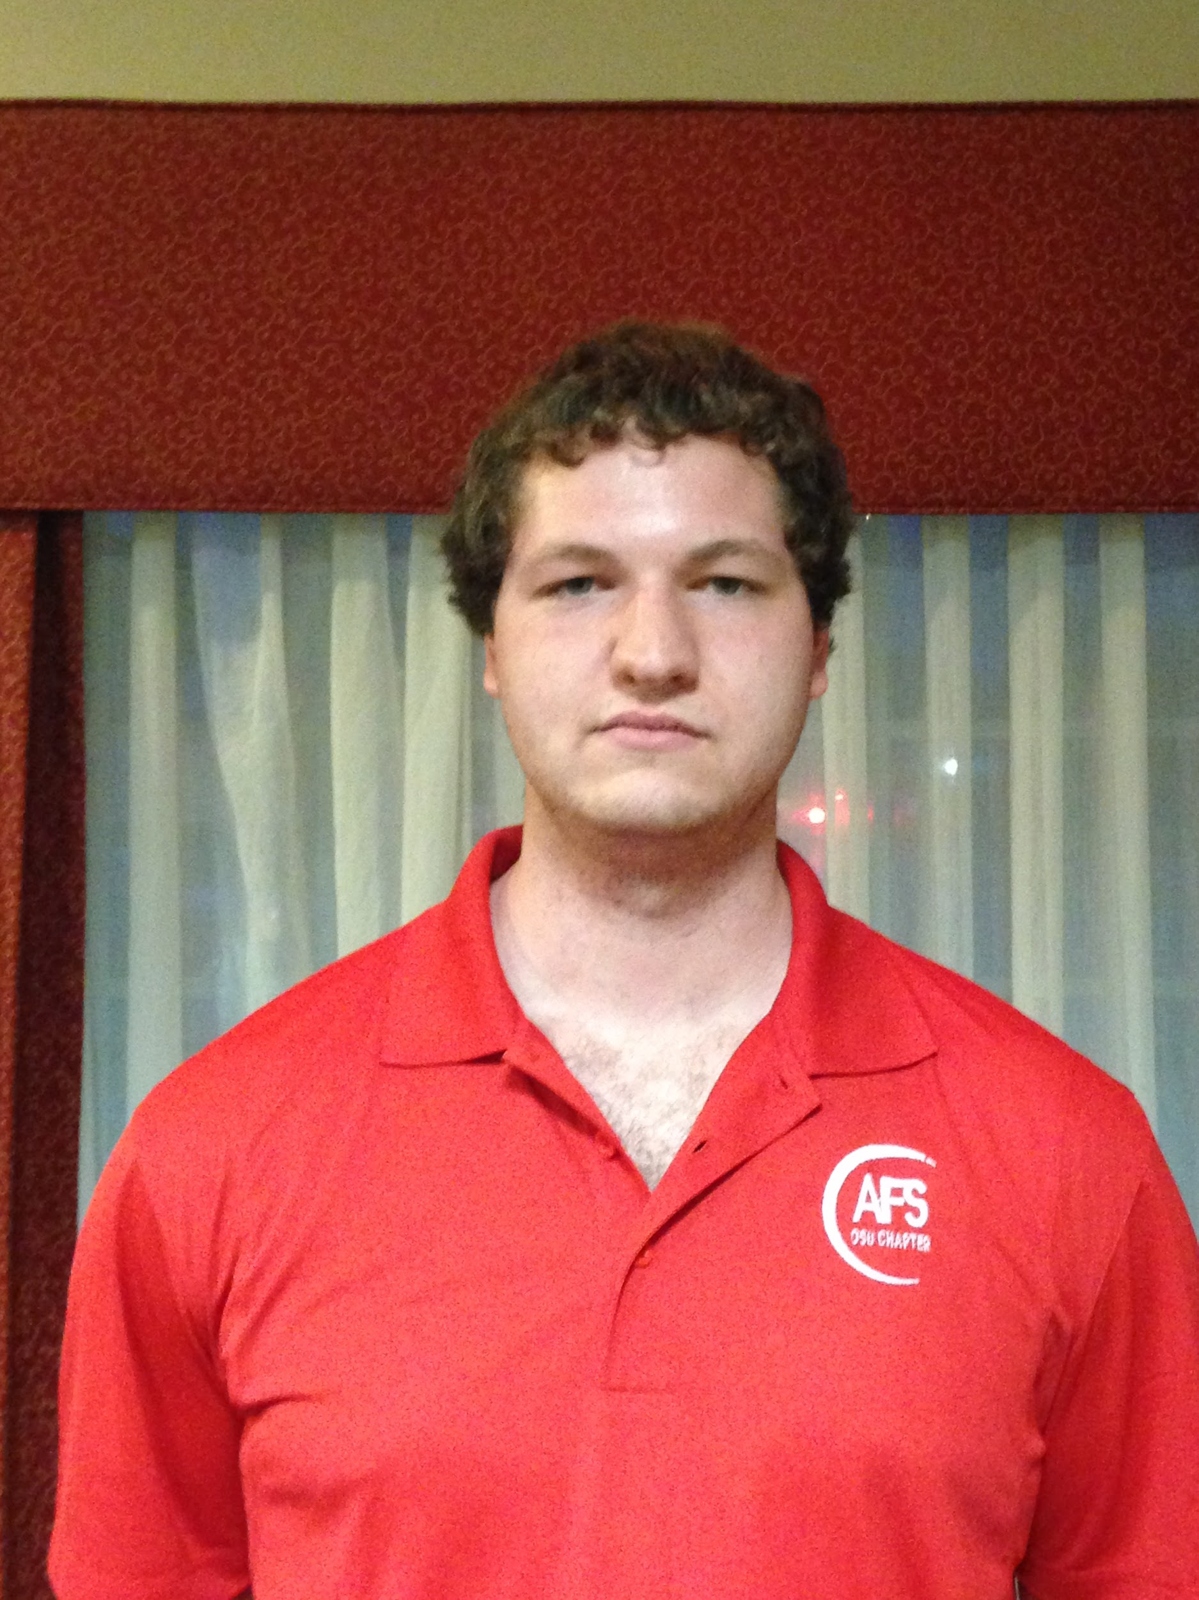
Michael Posner.20 - Treasurer
Major: 4th Year, Materials Science and Engineering with a focus in Polymers Graduation Date: May 2017 Research: Electrospinning and drug release Study Abroad: Beijing Sports University Hobbies: Travel, martial arts, football, basketball

Slide 6
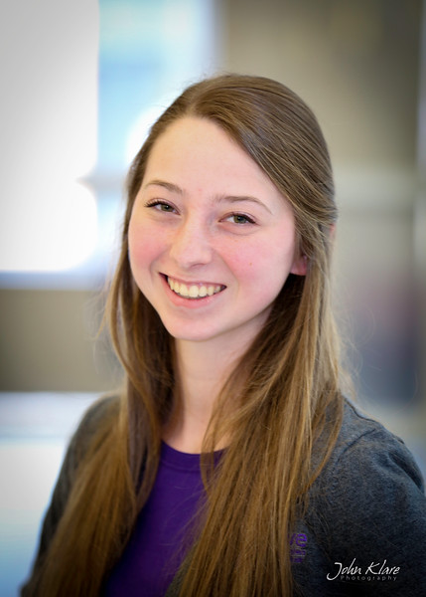
Kelsey Riffle.81 - Secretary
Major: 3rd Year, Materials Science and Engineering Graduation Date: May 2018 Internships: Summer 2016: ArcelorMittal, Associate Engineer – Metallurgical Intern, (Burns Harbor, IN) Hobbies: Snowboarding, cooking, traveling

Slide 7
What We Do

Slide 8
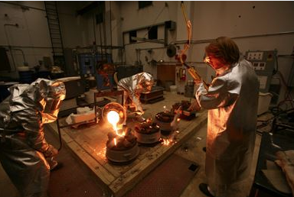
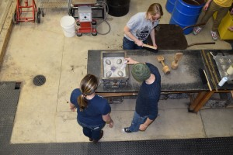
Foundry Meetings
Use previously made patterns
Create new patterns
We want your ideas! What do you want to cast?

Slide 9
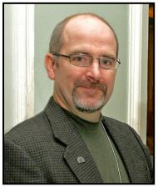
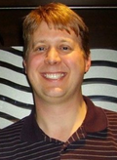
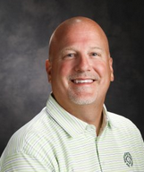
Professional Development Meetings
Local professionals join us and share different casting techniques
Great way to network!
Previous Presenters:
Larry Buergel: Fisher Cast Steel
Joeseph Muniza: ASK-CHEMICALS
Pete Satre: Allied Mineral Products
Wil Tinker: Tinker Omega

Slide 10
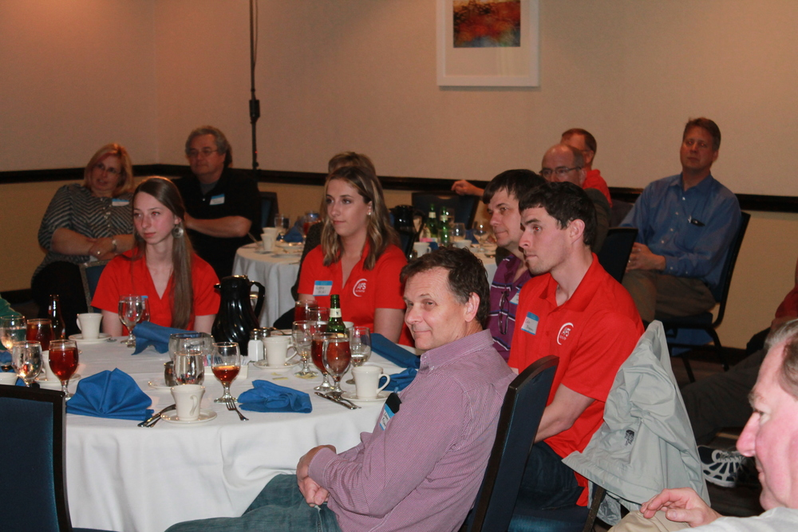
Local Chapter Meetings
Enjoy dinner with local professionals
More networking!
-Every Third Thursday of each Month
-Students Eat Free

Slide 11
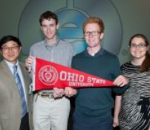
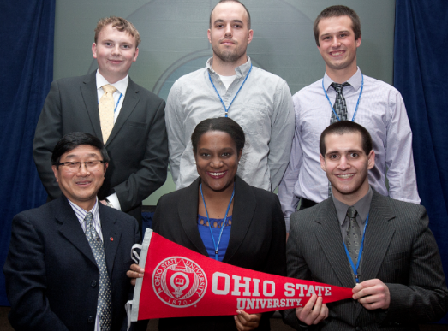
CIC Conference in Chicago
Annual Meeting in Chicago
-All Expenses Paid
-Job Fair for Foundry related jobs
-Wined/dined by industry professionals
-All Students walk away with offers
-Great Networking

Slide 12
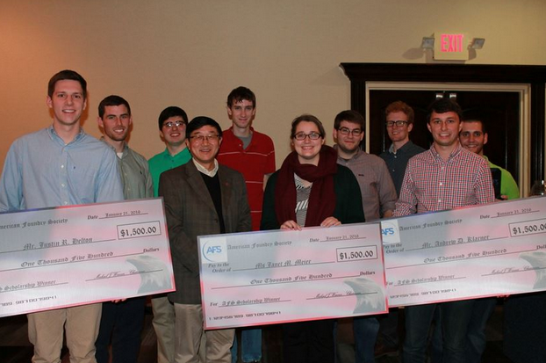
Scholarships
Annual Receive ~ $8,500 in scholarships
→ Annual Scholarship through FEF
Decided on by Dr. Luo/Colin
Give out 4-5 awards all $500+
→ Annual AFS Scholarship Award
Give out 2 awards of $1,500
→ Metal Casting Congress Awards
Potential of $1,000

Slide 13
Previous Projects

Slide 14
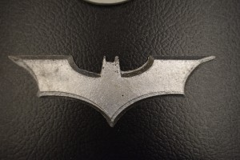
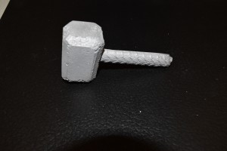
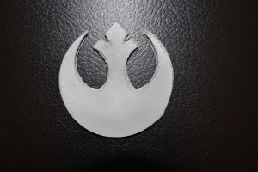
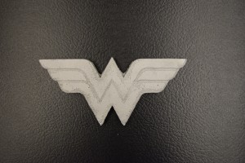
Comic Con Table Decorations

Slide 15
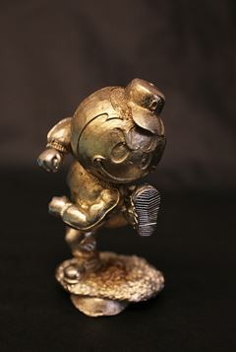
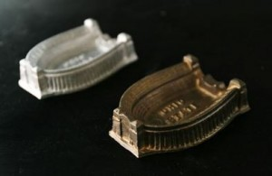
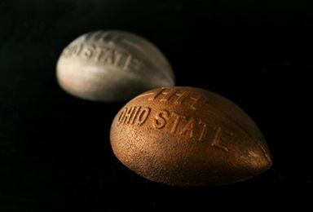
Ohio State Related Projects

Slide 16
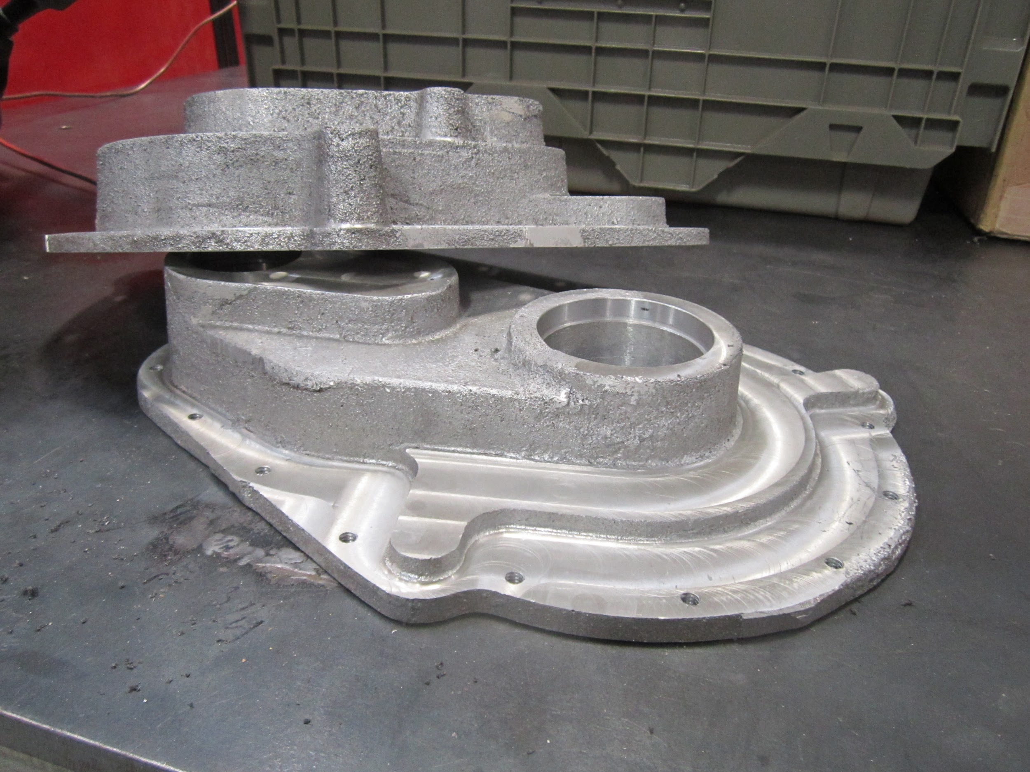
BAJA Buckeyes Gearbox

Slide 17
What’s Next?

Slide 18
We want your ideas! Have a project in mind? We can help to make it happen!

Slide 19
General Casting Knowledge

Slide 20
Professional Organizations to Join/Membership
All Students:
Required: Join FEF (Foundry Education Foundation)
→ It’s free and gives us more money for scholarships!
Optional: AFS (American Foundry Society)
→ $20 of which $15 comes back to the club
→ AFS Central Ohio Chapter will pay fees once a year for students!

Slide 21
Follow us on:
Twitter afs_osu Instagram afs.osu
Facebook Afs Osu
Be sure to visit the website for updates! http://u.osu.edu/afsatosu

